Slide 1
Trainer Action Pack
A Guide to the Session
Notes:
About this Action Pack
This session takes 60 minutes. The session includes information for you the presenter, activities for participants, and a debrief for each activity.
Notes Section
In the notes section, you will find a complete guide to each slide including timing, what to say, related activities and debriefs. You can read from the notes like a script or feel free to adapt and add to the content to make it relevant for your program. One thing to note is that instructions in italics are instructions to you, the presenter.
Activities
There are instructions throughout the session for both in-person and virtual versions of the activities. Use whichever format best suits your implementation of the session.
Debrief
Debriefs follow each activity and are comprised of two parts: Observe & Identify Concepts and Apply Concepts.
Observe & Identify: As the facilitator of the session, observe participants during the activity and be prepared to comment on your observations. Participants should identify concepts from the activity and discuss.
Apply Concepts: The last part of the debrief is taking the identified concepts and having participants discuss applying those concepts to the context of your program.
How to Adapt this Session
You can expand this session by:
Spending more time on the activities as needed or desired.
Adapting the examples and scenarios to align with your program.

Slide 2
The Why Behind the What
Seeing Behavior Through a New Lens
Notes:
1 min
0:00-0:01
Say
Description:
Discover how behavior reflects what youth may not be able to say in words. Learn to uncover root causes, use empathy, and redirect behavior in ways that preserve relationships. Gain strategies to provide support and respond to undesirable behaviors rather than reacting to them.
LinkedIn Post:
Materials Needed
If you are facilitating this training in-person:
If you are facilitating this training virtually:

Slide 3

What’s Underneath
Notes:
1 min
0:05-0:06
​
Say
When we look at icebergs, we are only seeing a small portion with the rest hidden under water. The same is true with the youth we work with. It’s important to keep in mind that we may only see the student’s reaction, we may not see what happened. It may be due to something that happened in that moment, but it also might be due to something underlying and non-visible.

Slide 4

Understanding Student Behaviors​
Unlearned skills
Unmet needs
Hunger
Lack of sleep
Trauma
Learned behaviors
Medical conditions
Behavior is communication​
Behavior is caused​
Notes:
3 mins
0:06-0:09
EXPLAIN​
Today we're going to start by shifting our perspective on student behavior. I want you to think about behavior as a form of communication - when students act out, withdraw, or display challenging behaviors, they're often trying to tell us something they can't express in words.
The first key principle is that behavior is communication. Every behavior, whether positive or challenging, is the student's way of communicating an underlying need, feeling, or experience. When a student is disruptive, they might be communicating that they're overwhelmed, bored, or seeking connection.
The second principle is that behavior is caused. Nothing happens in a vacuum. There's always something driving the behavior we observe.
Let's look at some common root causes:
Unlearned skills: Sometimes students simply haven't developed the social-emotional or academic skills needed for the situation
Unmet developmental or physical needs: Students may be struggling with age-appropriate expectations or basic physical needs
Hunger: A student who hasn't eaten may have difficulty concentrating or regulating emotions
Lack of sleep: Fatigue significantly impacts behavior and emotional regulation
Trauma: Past or current traumatic experiences can manifest in various behavioral responses
Learned behaviors: Students may have learned that certain behaviors get them what they need
Medical conditions: Some behaviors may be connected to underlying medical or neurological conditions
When we understand that behavior is both communication and caused by something specific, we can move from reacting to responding thoughtfully.​

Slide 5

Functions of Student Behaviors​
S | Sensory Stimulation
E | Escape
A | Attention
T | Tangible Access
Notes:
3 mins
0:09-0:12
​
Say​
Now that we understand behavior is communication, let's talk about what students are trying to communicate. Research shows us that all behavior serves one of four main functions, which we can remember with the acronym SEAT.
Sensory Stimulation (S): Students engage in behaviors to either seek pleasant sensations or escape uncomfortable ones. This includes both seeking stimulation when they're under-stimulated and seeking relief when they're over-stimulated. You might see jumping, hand-flapping, fidgeting, rocking, or other repetitive movements. These students are trying to regulate their sensory experience.
Escape (E): When students want to avoid something uncomfortable - whether it's a task, person, or situation - they use escape-seeking behaviors. This might look like running away, suddenly claiming illness, starting arguments, or creating disruptions that remove them from the situation they want to avoid.
Attention (A): Students seeking attention want feedback and connection from adults or peers. Importantly, they often don't distinguish between positive and negative attention - any attention meets their need. You'll see behaviors like tantrums over minor issues, interrupting, asking for help with tasks they can do independently, or sharing exaggerated stories to gain sympathy or praise.
Tangible Access (T): These students are trying to obtain something concrete they want - food, toys, privileges, or activities. Their behaviors might include begging, screaming, physical aggression, or grabbing to get what they're after.
Understanding these functions helps us respond more effectively because we can address the underlying need rather than just the surface behavior. We're going to apply this to some scenarios to see what function of behavior you think might be happening.
Source
Bucio, T. (2025, July 18). What are The Four Functions of Behavior? - Cultivate BHE. Cultivate Behavioral Health & Education. https://cultivatebhe.com/what-are-the-four-functions-of-behavior/
​

Slide 6
Sad Tina
Tina is a third-grade student. She’s always sad or upset when she gets to your program. She cries every afternoon during snack time. She often says things like “I don't want to be here” or “nobody wants to be my friend.” She tends to sit alone in the cafeteria to eat by herself.
You’ve never noticed kids being mean to her or excluding her during other activities.
Notes:
3 mins
0:12-0:15
Activity-In-person- Discussion
I have four scenarios to show you. I will read them, then I am going to ask you to discuss and share what you think the function of the behavior is.
Activity-Virtual- Poll/Unmute
I have four scenarios to show you. I will read them, then I am going to ask you to answer a poll with what you think the function of the behavior is. I will also be looking for someone to unmute to share their rationale.
Scenario
Tina is a third-grade student. She’s always sad or upset when she gets to your program. She cries every afternoon during snack time. She often says things like “I don't want to be here” or “nobody wants to be my friend.” She tends to sit alone in the cafeteria to eat by herself. You’ve never noticed kids being mean to her or excluding her during other activities.
Poll
Which function of behavior are we seeing in this scenario?
Access​
Attention​
Escape​
Sensory stimulation
Possible answer-Attention
Debrief​
Observe Share out.​
Identify Concepts Is this a function you observe regularly?​
Apply How does knowing the function of behavior impact your response?​

Slide 7
Temper Tantrum Sam
Once everyone is settled you begin by telling your group of fourth-graders they have 20 minutes to work on their assignments from the school day, and then they will get a snack.
Samuel throws his bookbag on the table and complains, “I don’t have any homework!” He pulls his pencil box out, dumps it on the floor, and starts throwing balls of paper at other students.
Notes:
3 mins
0:15-0:18
Scenario
Once everyone is settled you begin by telling your group of fourth-graders they have 20 minutes to work on their assignments from the school day, and then they will get a snack. Samuel throws his bookbag on the table and complains, “I don’t have any homework!” He pulls his pencil box out, dumps it on the floor, and starts throwing balls of paper at other students.
Poll
Which function of behavior are we seeing in this scenario?
Access​
Attention​
Escape​
Sensory stimulation
Possible answer-Access
Debrief​
Observe Share out.​
Identify Concepts Is this a function you observe regularly?​
Apply How does knowing the function of behavior impact your response?​

Slide 8
180° Julie
You have an art program at the high school, an activity that students say they wanted and chose to join. During the first quarter your group focuses on clay. One student, Julie, is incredibly engaged and productive.
During the second quarter, your program focuses on watercolors. Instead of working, Julie sits at her table constantly tapping her pencil, annoying her classmates.
Notes:
3 mins
0:18-0:21
Scenario
You have an art program at the high school, an activity that students say they wanted and chose to join. During the first quarter your group focuses on clay. One student, Julie, is incredibly engaged and productive. During the second quarter, your program focuses on watercolors. Instead of working, Julie sits at her table constantly tapping her pencil, annoying her classmates.
Poll
Which function of behavior are we seeing in this scenario?
Access​
Attention​
Escape​
Sensory stimulation
Possible answer-Escape
Debrief
Observe Share out.​
Identify Concepts Is this a function you observe regularly?​
Apply How does knowing the function of behavior impact your response?​

Slide 9
Shouting Zack
Zack is a new sixth grade student in your program. Zack frequently asks to step out because the classroom is too loud and his classmates are annoying.
During a group project on the local watershed, the room gets loud with student enthusiasm. Getting increasingly upset, Zack jumps out of his seat and screams at his classmates to shut up.
Notes:
4 mins
0:21-0:25
Scenario
Zack is a new fourth grade student in your program. Zack frequently asks to step out because the classroom is too loud and his classmates are annoying. During a group project on the local watershed, the room gets loud with student enthusiasm. Getting increasingly upset, Zack jumps out of his seat and screams at his classmates to shut up.
Poll
Which function of behavior are we seeing in this scenario?
Access​
Attention​
Escape​
Sensory stimulation
Possible answer-Sensory stimulation
Debrief​
Observe Share out.​
Identify Concepts Is this a function you observe regularly?​
Apply How does knowing the function of behavior impact your response?​

Slide 10
Reducing Student Behaviors
Function | Increase the Behavior​ | Decrease the Behavior​
Sensory stimulation​ | Remove options for more/less input​ | Provide options to meet needs
Escape​ | Chasing​ Pressure to engage​ | Plan for breaks​
Attention​ | Provide attention | Planned ignoring​ Redirection​
Tangible Access​ | Give access | Give access when goal is met​
Notes:
5 mins​
0:25-0:30
​
EXPLAIN
This chart is your roadmap for responding to behaviors based on their function. The key insight here is that the same response can either increase or decrease a behavior, depending on what function it serves for the student.
Let's walk through each function:
Sensory-Seeking Behaviors:
To increase: Remove their access to sensory input (though be careful - this can escalate behaviors)
To decrease: Provide appropriate options to meet their sensory needs proactively
Escape-Seeking Behaviors:
To increase: Avoid chasing the student or applying more pressure to engage, as this reinforces their need to escape
To decrease: Plan for appropriate breaks before the student becomes overwhelmed, teach coping strategies
Attention-Seeking Behaviors
To increase: If you want to encourage positive attention-seeking (like raising hands), provide the attention they're seeking
To decrease: Use planned ignoring for minor attention-seeking behaviors, or redirect the student to appropriate ways to get attention
Tangible Access-Seeking Behaviors:
To increase: Give them access to what they want
To decrease: Only provide access to desired items when behavioral goals are met, not when they're engaging in challenging behavior
The critical point is this: if you give a student what their behavior is designed to get, you'll see more of that behavior. If you withhold what their behavior is designed to get while providing it through appropriate means, you'll see less challenging behavior and more appropriate behavior.
For example, if a student is throwing a tantrum for attention, giving them attention during the tantrum increases tantrum behavior. But if you ignore the tantrum and give attention when they're calm, you'll see more calm behavior.

Slide 11
Behavior Traffic Controller
Sensory stimulation
Escape
Attention
Tangible access
Marcus always "forgets" his homework folder when it's time for homework help. When reminded, he gets upset and says his stomach hurts. Last week he threw his pencil and said, "I hate this stupid work!"
Notes:
3 mins
0:30-0:33
In-Person Activity – Voting/Discussion
We’re going to practice applying the functions of behavior and reduction strategies to real scenarios, acting as "traffic controllers" who direct appropriate responses. Review each scenario, then take a vote on which function of behavior you are seeing. Follow up with a discussion on how participants would work to reduce that behavior.
Virtual Activity – Annotation/Chat/Unmute
We’re going to practice applying the functions of behavior and reduction strategies to real scenarios, acting as "traffic controllers" who direct appropriate responses. Review each scenario, then use your annotation tool to select which function of behavior you are seeing in this scenario on the screen. Then we’d love to have you drop in the chat or unmute to share how you would use reduction strategies to mitigate the behavior.
Scenario
Marcus always "forgets" his homework folder when it's time for homework help. When reminded, he gets upset and says his stomach hurts. Last week he threw his pencil and said, "I hate this stupid work!"
What is the function of behavior here? Use your annotation tool to select on your screen.
Let us know in the chat how you would work to reduce this behavior. Facilitator then asks for a volunteer to unmute and share.

Slide 12
Behavior Traffic Controller
Sensory stimulation
Escape
Attention
Tangible access
During art activities, Jana constantly touches other students' supplies, taps her paintbrush loudly on the table, and rocks in her chair. She's most disruptive during independent work.
Notes:
3 mins
0:33-0:36
Scenario
During art activities, Jana constantly touches other students' supplies, taps her paintbrush loudly on the table, and rocks in her chair. She's most disruptive during independent work.
What is the function of behavior here? Use your annotation tool to select on your screen.
Let us know in the chat how you would work to reduce this behavior. Facilitator then asks for a volunteer to unmute and share.

Slide 13
Behavior Traffic Controller
Sensory stimulation
Escape
Attention
Tangible access
Every day at 3:00 PM, Aisha begins asking for snack even though snack time isn't until 3:30. She gets increasingly loud and persistent, sometimes crying or bargaining with staff.
Notes:
3 mins
0:36-0:39
Scenario
Every day at 3:00 PM, Aisha begins asking for snack even though snack time isn't until 3:30. She gets increasingly loud and persistent, sometimes crying or bargaining with staff.
What is the function of behavior here? Use your annotation tool to select on your screen.
Let us know in the chat how you would work to reduce this behavior. Facilitator then asks for a volunteer to unmute and share.
Debrief
Observe & Identify Concepts Share out. What strategies felt most natural to you?
Apply How could you use this approach in your daily work with youth?

Slide 14
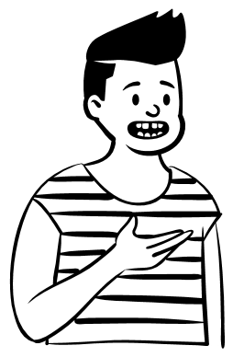
Affective Statements
I feel…
Notes:
1 mins
0:39-0:40​
Say
We make a lot of comments to students about how they are impacting others, but these are usually “don’t bother them” or “you have to clean up”. Affective statements are ones that acknowledge your feelings. Statements like “I am happy to see…” or “I am thankful that you…” So instead of saying “don’t bother them” you can say “I feel like you may be bothering X. Have you asked them about this?” or instead of “you have to clean up” you can say “I am thankful when you clean up. It keeps our environment healthy and safe.”

Slide 15
Convert “Telling” into Affective Statements
I’m feeling irritated that you were talking when I was leading the activity. I worked hard on this and think you will really like it when you learn more about it. Will you raise your hand when you want to talk?
Be quiet.
Notes:
2 mins
0:40-0:42
Activity- In-person- Discussion/Turn and Talk
“Be quiet” is a telling statements. How can you convert them to affective statements? Discuss with your neighbor and then we’ll have folks share their responses.
Activity-Virtual-Chat/Unmute
“Be quiet” is a telling statements. How can you convert them to affective statements? Let us know in the chat or feel free to unmute and share.
Click to display sample response
Be quiet. - I’m feeling irritated that you were talking when I was leading the activity. I worked hard on this and think you will really like it when you learn more about it. Will you raise your hand when you want to talk?

Slide 16
Convert “Telling” into Affective Statements
You just hurt Joe.
It made me uneasy to see you hurt Joe. Respect is an important thing to me and to our community. Can you tell me what is going on with you two?
Notes:
2 mins
0:42-0:44
Activity- In-person- Discussion
“You just hurt Joe” is a telling statements. How can you convert them to affective statements? Discuss with your neighbor and then we’ll have folks share their responses.
Activity-Virtual-Chat/Unmute
“You just hurt Joe” is a telling statements. How can you convert them to affective statements? Let us know in the chat or feel free to unmute and share.
Click to display sample response
It made me uneasy to see you hurt Joe. Respect is an important thing to me and to our community. Can you tell me what is going on with you two?

Slide 17
Convert “Telling” into Affective Statements
Don’t touch her.
I feel really uncomfortable when I see you touching them in the hall. I value all students feeling safe and secure. Would you be willing to talk about what is going on between you two?
Notes:
2 mins
0:44-0:46
Activity- In-person- Discussion/Turn and Talk
“Don’t touch her.” is a telling statement. How can you convert them to affective statements? Discuss with your neighbor and then we’ll have folks share their responses.
Activity-Virtual-Chat/Unmute
“Don’t touch her.” is a telling statement. How can you convert them to affective statements? Let us know in the chat or feel free to unmute and share.
Click to display sample response
I feel really uncomfortable when I see you touching them in the hall. I value all students feeling safe and secure. Would you be willing to talk about what is going on between you two?
Debrief
Observe & Identify Concepts Comment on responses. How easy was it to turn telling statements into affective statements?
Apply Concepts How can you check yourself before speaking so that your statements are more affective verses telling?

Slide 18

Small Impromptu Conversations
Immediate
Brief
Restorative questions
Proactive or reactive
Notes:
2 mins
0:46-0:48
Say
Small impromptu conversations are held before an issue occurs or immediately after. These are short – less than 5 minutes – and may use the restorative questions.
80% of these conversations should be proactive and 20% should be reactive. That means that you should be having these conversations regularly, before you have disciplinary issue. They can be used to reflect on what is happening in the classroom, even good things.

Slide 19
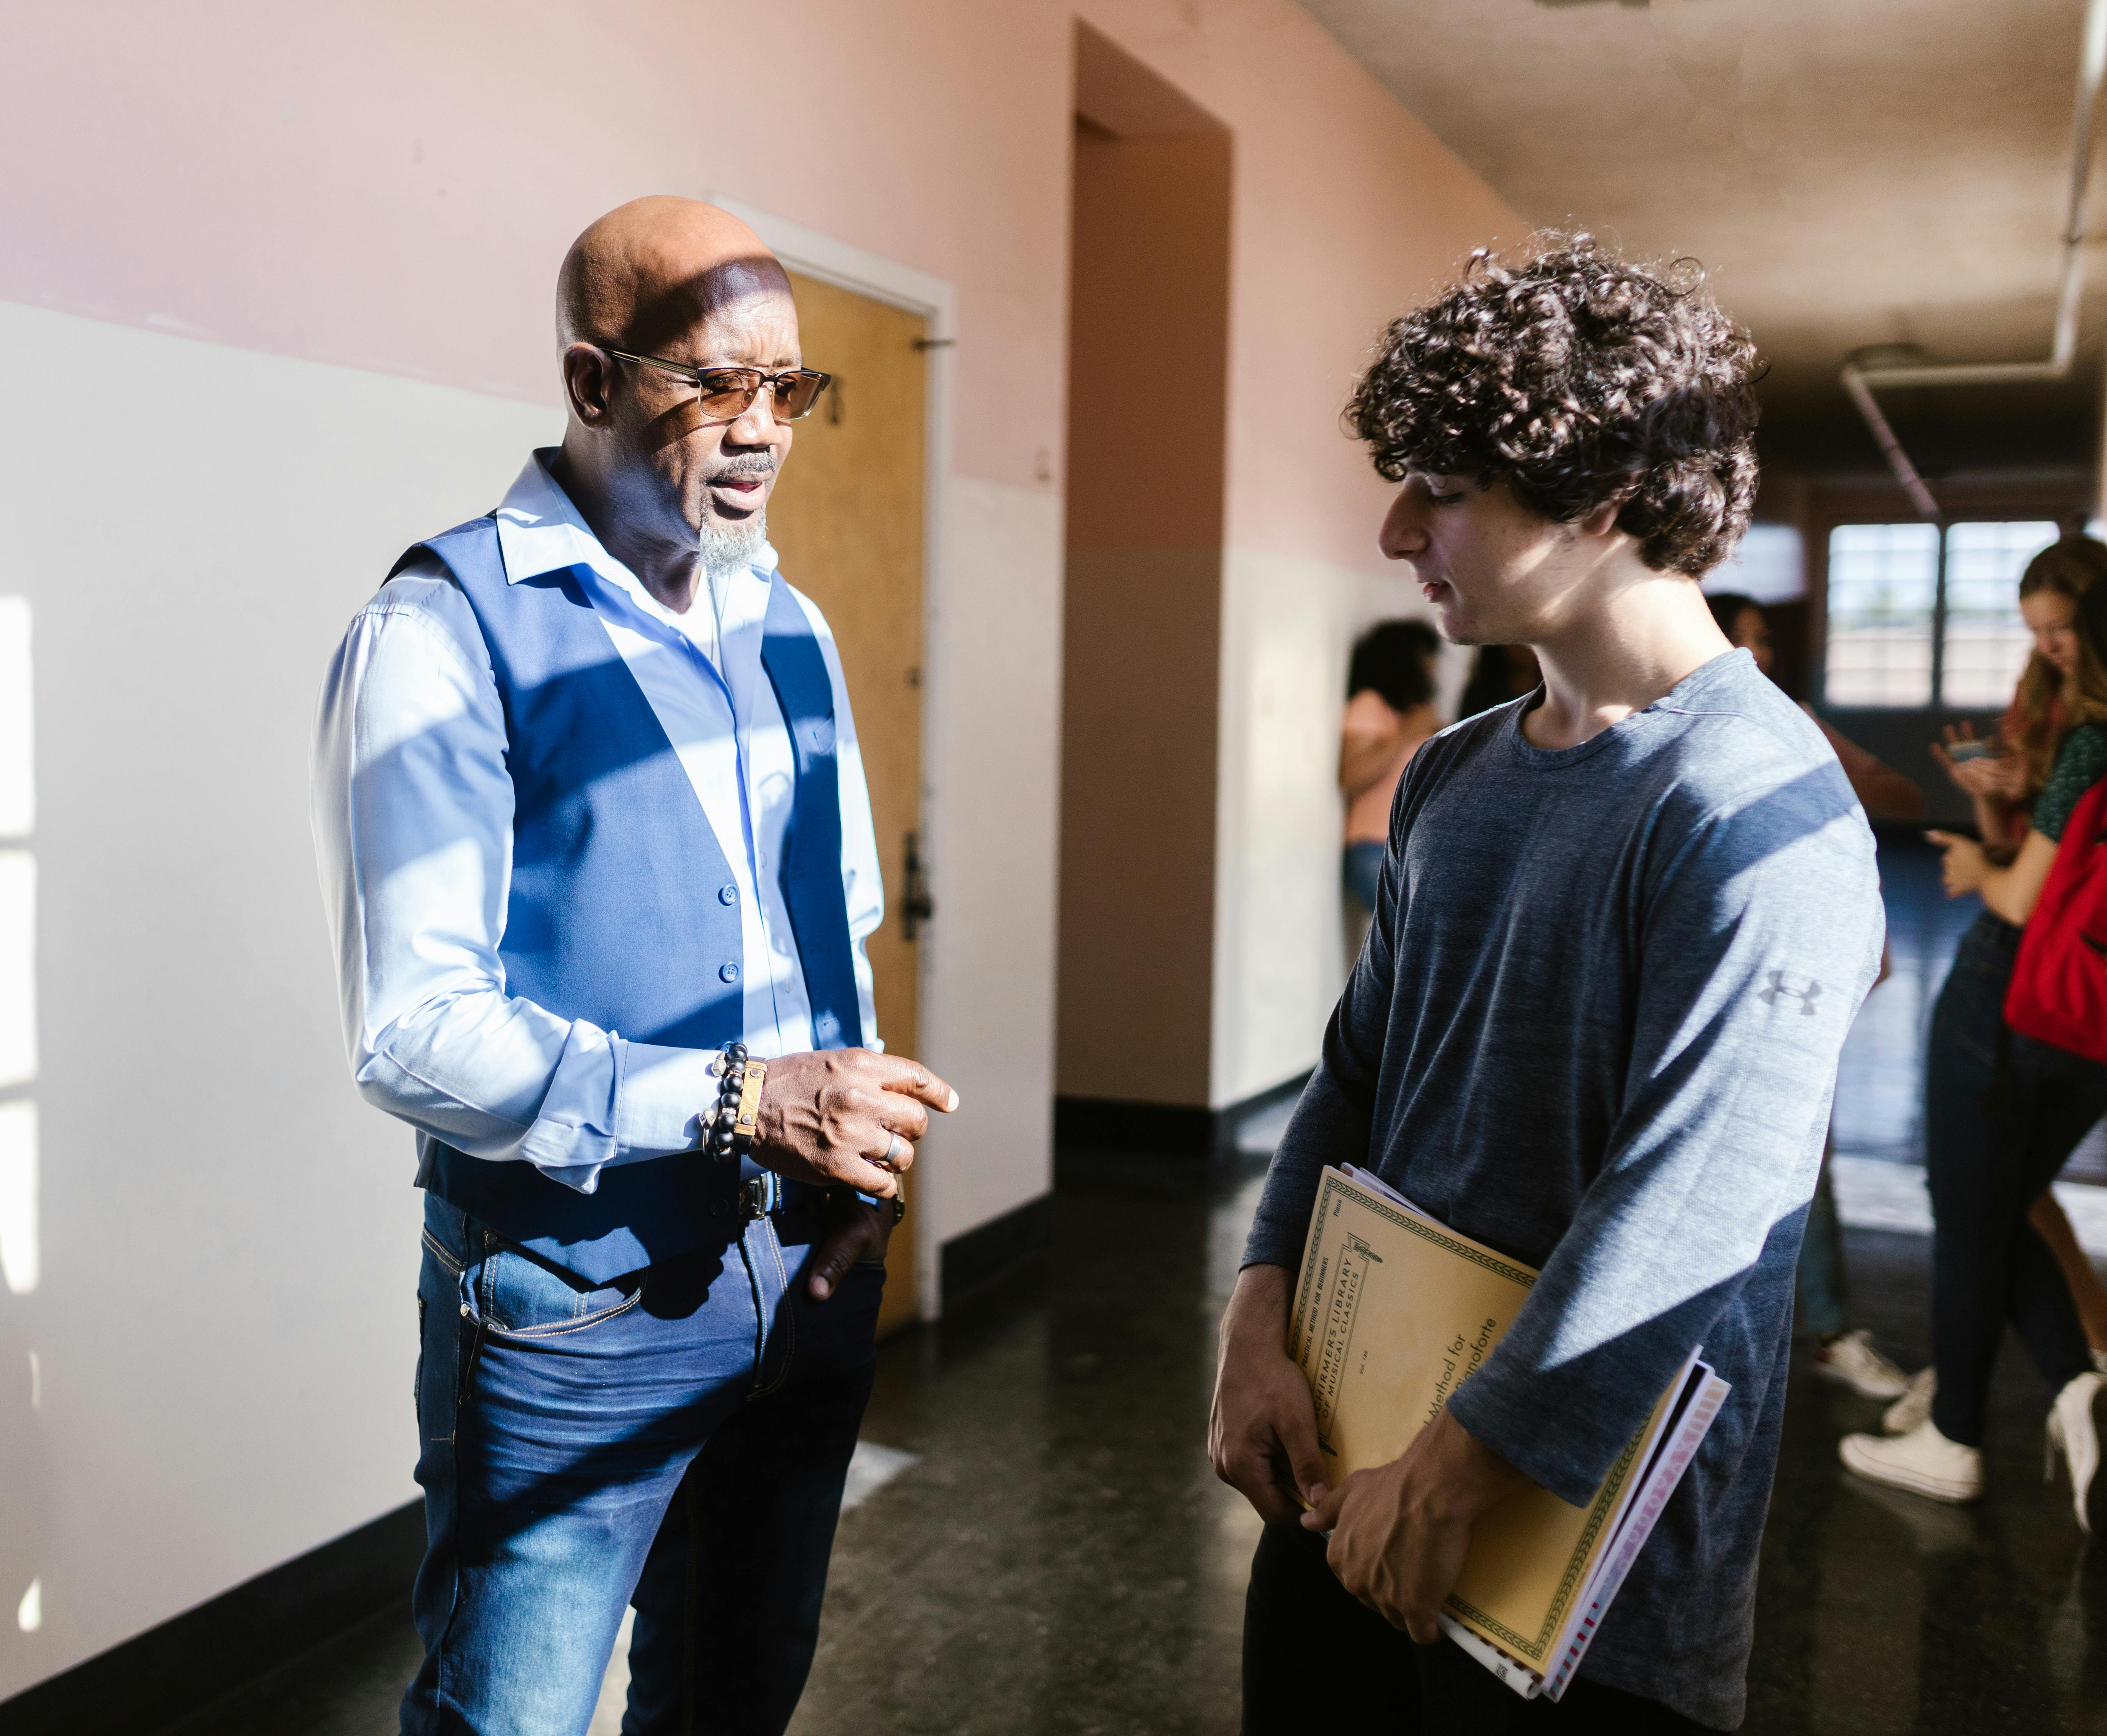
Restorative Questions
What happened?
What were you thinking of at the time?
What have you thought about since?
Who has been affected by what you have done? In what way?
What do you think you need to do to make things right?
Notes:
4 mins
0:48-0:52
Say
These five restorative questions are powerful tools for helping students reflect on their actions and develop accountability. Unlike punitive approaches that focus on consequences, these questions help students understand the impact of their behavior and take ownership of making things right. Let's break down each question and why it's effective:
"What happened?" - This is a neutral, open-ended question that allows the student to share their perspective without feeling judged. It helps them organize their thoughts and gives you insight into how they experienced the situation.
"What were you thinking of at the time?" - This question helps students connect their thoughts to their actions. It develops self-awareness and helps them understand that their thinking influences their behavior.
"What have you thought about since?" - This encourages reflection and shows whether the student has gained new insights since the incident. It often reveals that students already understand what went wrong.
"Who has been affected by what you have done? In what way?" - This is where empathy develops. Students consider the impact of their actions on others, including peers, staff, and themselves. This question helps them understand that their actions have ripple effects.
“What do you think you need to do to make things right?" - This empowers students to generate solutions rather than having consequences imposed on them. When students come up with their own plan for repair, they're more invested in following through.
These questions work best when asked with genuine curiosity, not as an interrogation. Give students time to think and be prepared for "I don't know" responses - that's often where the learning begins. The goal is to guide students toward understanding and responsibility, not to get them to admit guilt.

Slide 20

Notes:
3 mins
0:52-0:55
Say
As we begin to wrap up our time today, we want to share with you a sample of a conversation where an adult is using these restorative questions to help a young person work through what they are experiencing.
Click to play video
As we observed, the adult did more than just ask these questions. The conversation began with very positive comments and even offering gratitude. These things are important to keep in mind because it will go a long way in restoring relationships with youth and supporting them through the challenges they experience.
Source
https://youtu.be/aw4LwL86YNA

Slide 21
Keep It Going
Identify SEATs
Practice “I” statements
Utilize the 5 restorative questions
Notes:
3 mins
0:57-1:00
Say
As you leave today, keep your practice going by:
As youth present undesirable behaviors, first think of SEAT and work to identify the true message they are trying to convey.
Practice reframing your language so that you use “I” statements when addressing misbehavior
The next time you have a challenging behavior that you are trying to discuss with a young person, utilize the 5 restorative questions to guide your conversation.

