Slide 1
Trainer Action Pack
A Guide to the Session
Notes:
About this Action Pack
This session takes 60 minutes. The session includes information for you the presenter, activities for participants, and a debrief for each activity.
Notes Section
In the notes section, you will find a complete guide to each slide including timing, what to say, related activities and debriefs. You can read from the notes like a script or feel free to adapt and add to the content to make it relevant for your program. One thing to note is that instructions in italics are instructions to you, the presenter.
Activities
There are instructions throughout the session for both in-person and virtual versions of the activities. Use whichever format best suits your implementation of the session.
Debrief
Debriefs follow each activity and are comprised of two parts: Observe & Identify Concepts and Apply Concepts.
Observe & Identify: As the facilitator of the session, observe participants during the activity and be prepared to comment on your observations. Participants should identify concepts from the activity and discuss.
Apply Concepts: The last part of the debrief is taking the identified concepts and having participants discuss applying those concepts to the context of your program.
How to Adapt this Session
You can expand this session by:
Spending more time on the activities as needed or desired.
Adapting the examples and scenarios to align with your program.

Slide 2
Catch Them Doing Good:
The Power of Positive Reinforcement
Notes:
1 min
0:00-0:01
Say
Description:
Learn how to spot and celebrate positive behavior moments that can transform group dynamics. Explore strategies to give feedback that sticks and motivates youth toward continuous improvement. Gain confidence in replacing punitive measures with encouragement-based approaches.
LinkedIn Post:
Materials Needed
If you are facilitating this training in-person:
If you are facilitating this training virtually:

Slide 3
The Foundation
Positive Relationships
Positive Environment
Positive Behavior
Notes:
2 mins
0:05-0:07
​
Say​
When it comes to positive reinforcement it boils down to this: when we build positive relationships with youth and create a positive environment for them to be in, it results in positive behavior. That is our foundation.
Studies consistently demonstrate that positive adult-youth relationships serve as the primary mechanism through which young people develop social-emotional skills, academic motivation, and healthy identity formation. The National Research Council identified caring relationships with adults as one of the key features of positive developmental settings. Search Institute frame this and defines it as Developmental Relationships. To dive more into building these relationships with youth, check out The Welcome Toolkit on-demand on The Dash. These relationships provide youth with emotional support, opportunities for skill-building, and models of positive behavior.
Source
National Research Council. (2002). Community programs to promote youth development. National Academies Press.

Slide 4
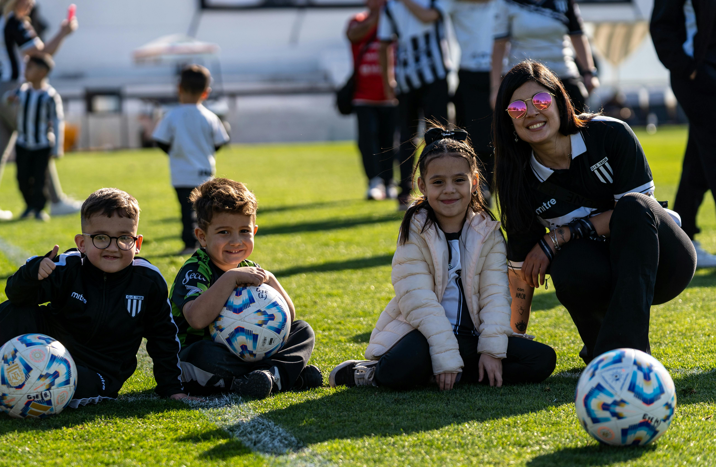
Activities for Relationship Building
One-on-one check-ins (formal and informal)
Interest-based conversations
Shared experiences and activities
Active listening and validation techniques
Notes:
2 mins
0:07-0:09
​
Say​
Let’s review briefly some things you can do to begin to build positive relationships with you. Effective relationship-building activities should be authentic and youth-centered. Regular check-ins provide predictable opportunities for connection, while informal conversations during transitions or activities help build rapport. Engage in conversations with them about their interests! Shared experiences create positive memories and common ground. Active listening involves giving full attention, reflecting feelings, and asking open-ended questions that demonstrate genuine interest in the young person's perspective and experiences.

Slide 5
Rebuilding Connection
2 minutes
10 days
Use the "2x10" strategy
Start with genuine curiosity about each young person
Look for strengths and interests, not just problems
Notes:
2 mins
0:09-0:11
​
Say​
But what about when we need to do a little restoration of those relationships? Refreshing relationships means approaching each interaction with fresh eyes and renewed commitment. The "2x10" strategy, developed by Raymond Wlodkowski, involves spending two minutes of personal time with a youth for ten consecutive days in a row, focusing on their interests and strengths rather than academic or behavioral concerns. This simple practice has been shown to significantly improve relationship quality and reduce challenging behaviors.
Source
E. C. Henze, E., Burley, T., Coon, T., Boggs, S., & Kemp, A. (2024). Validating the 2x10 intervention. Contemporary School Psychology. https://doi.org/10.1007/s40688-024-00524-5

Slide 6

How Are Your Relationships with Youth?
What challenges do I face?
What is the quality of my relationships with youth?
What are my strengths?
Notes:
5 mins
0:11-0:16
​
Activity- In-person- Self-reflection/Discussion
We’ll take some time to do a little self-reflection and discussion. In groups of 3-4, discuss your quality of relationships with the youth you serve, what strengths you have with building connection and what challenges you encounter. We’ll come together in a few minutes to share out. Click to play music. When music ends, bring the groups together to share.
Activity- Virtual- Poll
We’re going to launch a poll with 3 questions. Take a moment to reflect and answer the poll questions while some music plays in the background. Click to play. Launch poll.
Poll
Rate the quality of your relationships with the youth you serve (1-10 scale)
What are your strengths in building relationships with young people?
What challenges do you face in connecting with youth?
Click to stop music if needed.
Debrief
Observe & Identify Concepts Comment on responses. What do we have in common when it comes to relationships with youth?
Apply Concepts How could the 2X10 strategy support you in the challenges you have connecting with youth?
​

Slide 7
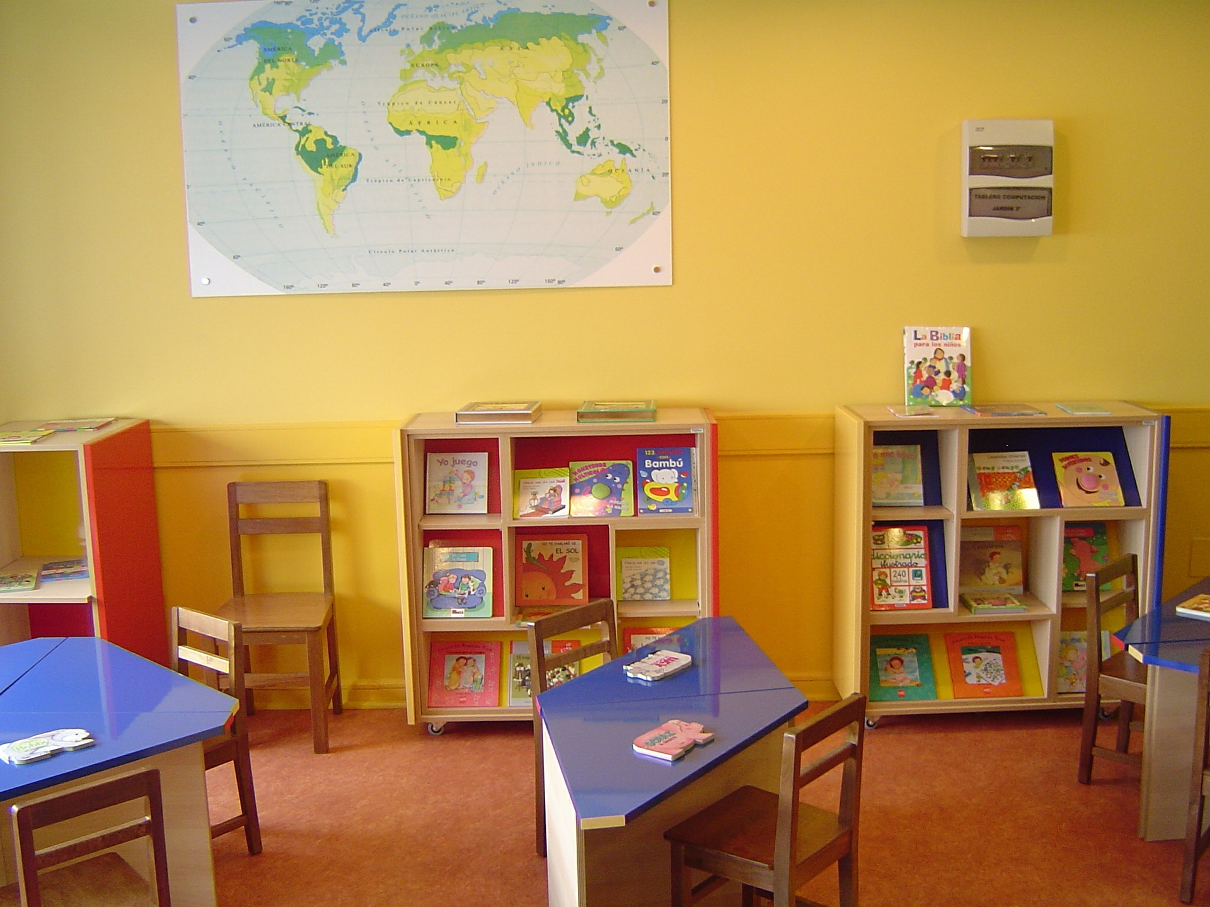
Creating a Positive Environment
Set up physical space
Utilize a schedule
Develop expectations
Clarify positive and negative consequences
Plan student-centered learning activities
Notes:
2 mins
0:16-0:18
​
Say​
Positive relationships is only one part of the equation. Positive behavior is supported by a positive environment. As we work on creating a positive learning environment, there are five things we can do:
Set up physical space to be an environment where youth feel welcome, included, and safe.
Utilize a schedule to support the flow of their engagement in your program.
Develop expectations that everyone can agree on and meet.
Clarify positive and negative consequences so that they understand what happens as a result of behavior.
Plan student-centered learning activities to increase interest and engagement while minimizing disruption and misbehavior.
We will look at each of these a little closer.

Slide 8
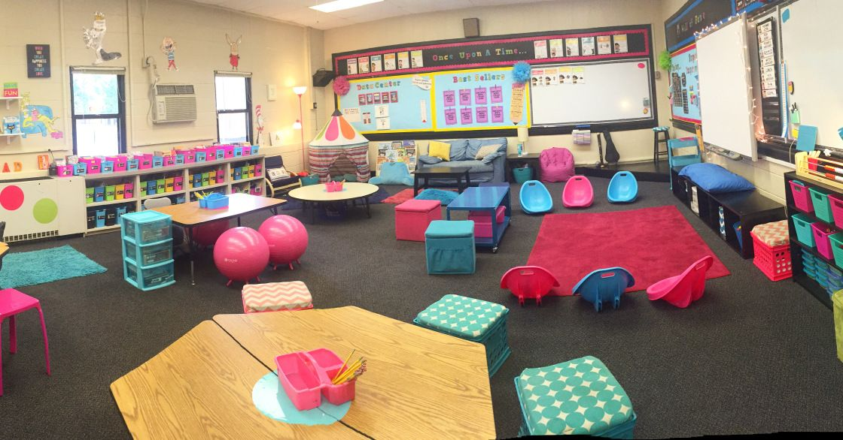
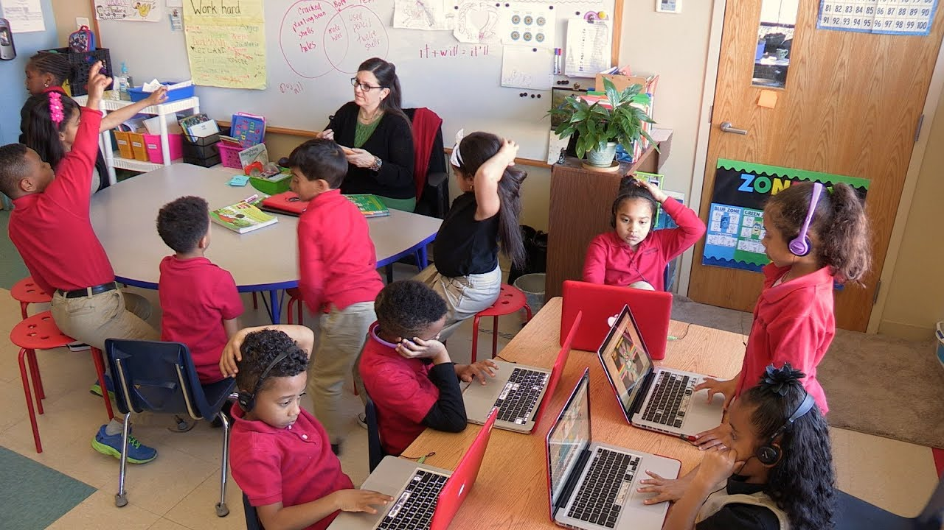
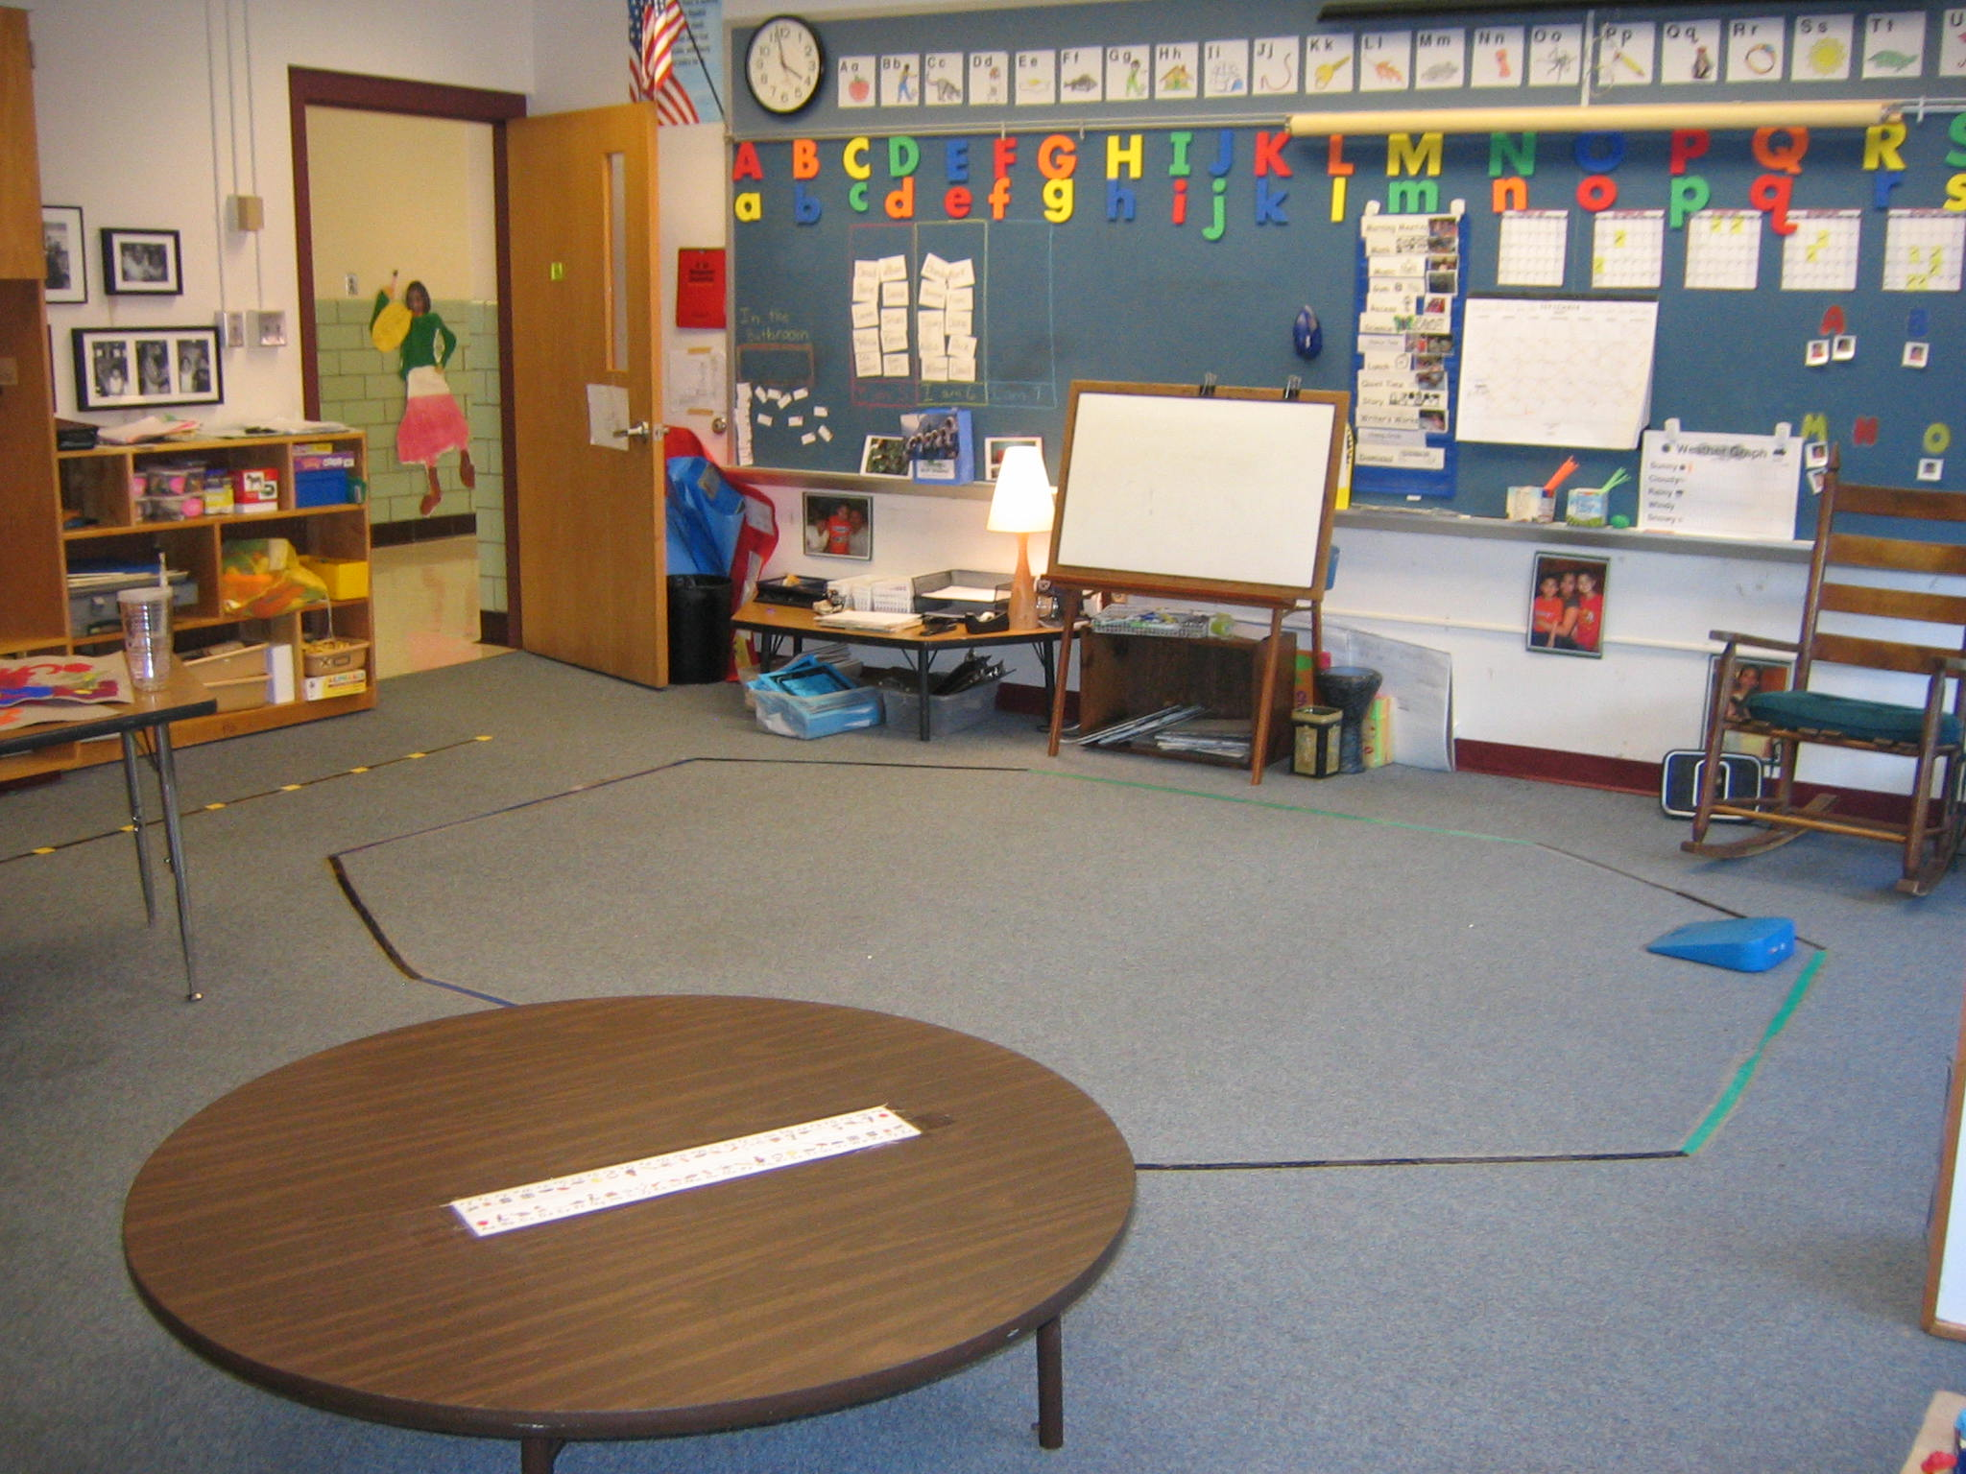
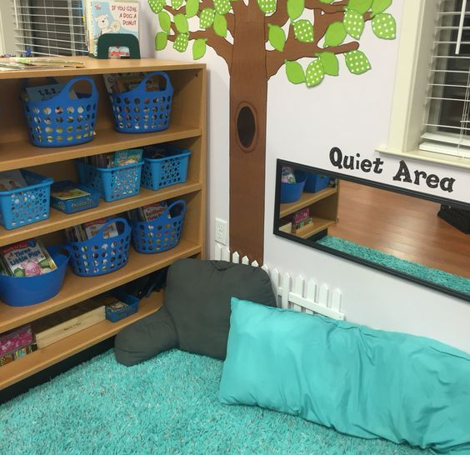
Your Physical Space
Notes:
3 mins
0:18-0:21
​
Say​
Depending where you are in your program year, you may have already done this, but it's something worth thinking about no matter what time of year it is as sometimes making small adjustments to your space can assist in mitigating undesirable behaviors.
As you consider your physical space, you may have lots of flexibility because your program is at a clubhouse or you may be very limited because your program is housed in a school using a teacher’s space. Your physical space should be set up to meet students’ needs. Some considerations you should make are:
Flexible seating – Youth have sat in desks all day, likely facing front. For some this is effective. For others they will be better able to focus facing a wall (distraction), sitting on the floor or using a beanbag chair (comfort) or standing up (movement). A small blanket, a music stand, or a few beanbag chairs can help you create a space where they can relax in and focus.
Click to display picture.
Station learning – Utilizing stations, different activities, can provide choice – giving youth opportunity to have a say in what they want to do. Stations can also be used to allow youth who need extra help to get it or those who need a challenge to get this support. Pushing a few desks together and offering an activity, is an easy way to set this up.
Click to display picture.
Movement spaces – After school, youth need an opportunity to move – be active – creating an open space and using it in your program can be central to helping them transition and let out their energy in appropriate ways. This can mean shoving desks aside or rearranging the space.
Click to display picture.
Quiet spaces – Programs can be overwhelming for some, or they can be tired after spending all day in school. Creating a quiet space that youth can retreat to can help them manage themselves and help them meet their own needs so that they can engage in your program in appropriate ways.

Slide 9
Schedule = Time + Activity + Attention
Allotted time
Engaged time
Activity length
Attention span
Notes:
2 mins
0:21-0:23
​
Say​
When you use a program schedule, you create an environment that is predictable and structured, which benefits youth. Several considerations to make as you plan your schedule and activities within it are:
Allotted time vs. engaged time – You may look at your schedule and see 45-minute blocks. It is important to make sure that as much of that time is engaged time as possible. It is very easy to take a 45-minute time slot and spend 10 minutes settling in and 15 minutes cleaning up, so youth only spend 20 minutes on learning activities. Developing procedures can help with that, but also being intentional about using your time well can help.
Attention span – What is the attention span of your students? 5 to 15 minutes depending on their age. Having 45 minutes and making sure that students are engaged the whole time doesn’t mean that you should plan to talk for 45 minutes. Instead, making sure that your activities have multiple components and that they keep students engaged and offer variety.
Activity length – Is 45-minutes too short to do what you want to? Consider breaking up activities over several sessions in order to get the best product.

Slide 10
Develop Expectations
Rules
Expectations
Norms for interactions
Dos & Don’ts
Vary in length
Housed in handbook or manual
3-5 statements
Use everyday language
Visibly posted
Notes:
1 min
0:23-0:24
​
Say​
We have rules, and these are important. But these don’t support the positive learning environment we are attempting to make. The rules are what you can and can’t do, but the expectations are how you expect students to engage in the activities. They are statements of how everyone (youth and staff) will interact in 3-5 statements. They will be written in everyday language.
Setting these expectations or as we sometimes call them, norms, is best done with the students. For more on how to develop these, check out Culture by Design in on-demand training on The Dash.

Slide 11
Clarify Consequences
Negative
Verbal warning
Time out
Written warning
Remove from activity
Send home
Positive
Attention
Responsibilities
Choice
Prizes
Consequence:
the effect, result, or outcome of something occurring earlier.
an act or instance of following something as an effect, result, or outcome.
Notes:
4 mins
0:24-0:28
​
Say​
It is important that we revisit the definition of consequences. In many cases, we default to consequences being the result of something negative, but here we see the definition does not allude to a singular positive or negative outcome. We can help youth understand the positive and negative consequences of their behavior through rewards and correction, penalties, and discipline . Desirable behavior must bring rewards and undesirable behavior should be corrected, penalized in some cases, and even disciplined.
Click to display positive consequences. Positive Sometimes it is easy to offer nothing for desirable behavior. That youth who “act right” are expected to sit quietly and do their work, not rewarded for this behavior. Be sure to plan rewards that encourage this behavior. Some possible rewards can be:
Attention – Some crave attention and giving it to them can be a reward.
Responsibilities – Giving youth responsibilities (paper passer, line leader, teacher for the day, etc.) are free rewards that they (particularly K-5) crave.
Choice – Youth should have choice throughout the program, but opportunities for additional choice can be used as additional rewards. For example, allowing them to choose between kickball and pickle ball as a reward can be effective.
Prizes – These are what we think of as rewards most commonly and probably the most expensive – the only expense – of the rewards.
Keep in mind, that we want to be supporting and building intrinsic motivation in youth for desirable behavior. Not every reward has to be tangible or special. Reinforcing positive behavior that you see with acknowledgment goes a long way. We’ll touch on acknowledgement a little later today.
We'd love to hear from you in the chat. What rewards do you use in your program?
Click to display negative consequences.
Negative You also have a series of consequences written that can be used in response to behavior. It is important that both you and the youth are aware of what these are. Not to be threats, but instead to support a positive environment where they know what will happen if their behavior is not in alignment with the expectations.
Source
Dictionary.com | Meanings & Definitions of English Words. (2025). In Dictionary.com. https://www.dictionary.com/browse/consequence

Slide 12

Youth-Centered Activities
Project based learning
Service and expeditionary learning
Other hands-on youth-led opportunities
Notes:
1 min
0:28-0:29
​
Say​
Finally, when we plan youth-centered activities, we are creating a positive learning environment. These are activities where students lead the inquiry and are hands on. Some examples of student-centered activities include:
Project based learning: where students actively explore real-world problems and challenges through sustained projects, developing knowledge and skills by creating products, presentations, or solutions
Service and expeditionary learning: Service learning combines academic learning with meaningful community service, allowing students to apply skills to meet real community needs while reflecting on their experiences to deepen understanding. Expeditionary learning is also a hands-on model that is inquiry-based where students engage in in-depth explorations that integrate multiple subjects.
Other hands-on student-led opportunities
Youth-centered activities are essential to creating a positive learning environment and to positive behavior management. After spending so much time on organizing our space and setting expectations, you can still have a negative environment where youth don't want to be or where they don't engage because they are unhappy or unfulfilled.

Slide 13
Motivate or Deflate
Giving out prizes
Having a say in program activities
Special privileges
Public recognition
Awards or certificates
Comparison to others
Remember something personal
Earning points
Being volunteered
Extra activity time
Displaying their work
Program chores
Motivate
Autonomy
Deflate
Control
Connection
Purpose
Recognition
Comparison
Dismissal
Criticism
Notes:
7 mins
0:29-0:36
In-Person Activity – Discussion
We're going to do a quick exercise to examine what energizes youth versus what drains their motivation. Think about the young people you work with - what lights them up, and what shuts them down? Some suggestions are on the screen, but feel free to add your own ideas.
Virtual Activity – Annotation/Chat
We're going to do a quick exercise to examine what energizes youth versus what drains their motivation. Think about the young people you work with - what lights them up, and what shuts them down? Using your annotation tool, which of these things motivates your youth?
Debrief
Observe & Identify Concepts What themes emerge with the things that motivate youth? What about the things that don’t? Click to display comparison. We can see that key motivators are autonomy, connection, purpose, and recognition. Things that can contribute to poor motivation include overly controlled settings, comparison to others, criticism, and dismissal of needs and preferences.
Apply Why does this matter for how we design our programs and interactions?
This quick exercise shows us that motivation isn't about complicated reward systems (although youth love prizes and incentives) - it's often about basic respect, choice, and recognition. As we move into our next section, keep these insights in mind. The physical and emotional environment we create feeds positive behavior.

Slide 14

The Philosophy of Positive Behavior Support
Punishing unwanted behavior
Shame in misbehavior
Reactive
Punishing unwanted behavior
Teaching/reinforcing desired behavior
Shame in misbehavior
Maintain dignity and respect
Reactive
Proactive
Notes:
2 mins
0:36-0:38
​
Say​
We want to lean into a little more how you can support positive behavior in your places and spaces. Have you heard the term Positive Behavior Support or PBS for short. PBS represents a paradigm shift from traditional punitive approaches to a proactive, educational model. It started with understanding that behavior is communication. Based on applied behavior analysis principles and understanding the functions of behavior, PBS emphasizes understanding the function of behavior and teaching replacement skills. Research demonstrates that PBS approaches lead to better long-term outcomes, stronger relationships, and more positive school climates compared to purely punitive systems (Horner & Sugai, 2015). To learn more about the functions of behavior, check out the training from October The Why Behind the What available on-demand on The Dash.
Click to display animation.
The shift comes when instead of punishing youth for unwanted behaviors, instead we teach or reinforce the desired behaviors. It also moves from shame and blame with misbehavior to maintaining dignity and respect when addressing it. It is a proactive approach as opposed to a reactive approach to addressing behavior.
Source
Horner, R. H., & Sugai, G. (2015). School-wide PBIS: An example of applied behavior analysis implemented at a scale of social importance. Behavior Analysis in Practice, 8(1), 80-85. https://doi.org/10.1007/s40617-015-0045-4

Slide 15

Encouragement Without Damage
Separate the person from the behavior
Use "I" statements and describe impact
Offer choices and maintain agency
Follow up privately
Notes:
2 mins
0:38-0:40
​
Say​
The key to maintaining relationships while addressing behavior is to preserve the young person's dignity and sense of agency. This involves using language that focuses on specific behaviors rather than character judgments, explaining the impact of behaviors on others, and providing opportunities for the youth to problem-solve and make better choices. Research shows that approaches that maintain relationship quality while addressing behavior, lead to better compliance and fewer repeat incidents (Cohen et al., 2009). So how do we do this?
First, separate the individual from the behavior understanding that however the behavior presents, it ultimately is a message that their needs are not being met in some way.
Utilize “I” statements and provide an explanation as to how the behavior impacts themselves, you, others in the program, and even the program as a whole.
Offer choices while maintaining agency. This means that you are giving them options of what comes next, but that ultimately it is up to them which option they choose. We just have to make sure there is understanding around what the consequences may be, positive or negative.
It’s also important to tailor your response and support to the size of the problem. What I mean by that, is in many if not all cases, it is better to have a private conversation with youth about their behavior. It shows respect and offers them safety to work through whatever it is that they need to work through.
Facilitator provide examples as possible.
Source
Cohen, J., McCabe, L., Michelli, N. M., & Pickeral, T. (2009). School climate: Research, policy, practice, and teacher education. Teachers College Record, 111(1), 180-213.

Slide 16

Redirecting Behavior
Use neutral, non-judgmental language and tone
Provide alternatives
Connect to natural consequences and learning opportunities
Allow processing time and space
Notes:
2 mins
0:40-0:42
​
Say​
Effective redirection involves guiding youth toward better choices without shaming or blaming. This requires clear communication about expectations, specific suggestions for alternative behaviors, and connection to meaningful consequences that promote learning rather than punishment. The goal is to help youth develop internal motivation and self-regulation skills that will serve them beyond the immediate situation. Here are somethings to keep in mind when redirecting behavior:
It is important to keep your voice calm. Use neutral, non-judgmental language and tone.
We mentioned this a moment ago but provide specific alternatives and options for what to do instead of the undesirable behavior.
Make sure that they connect their behaviors to natural consequences and use it as a learning opportunity. You have to set this understanding up as we have discussed previously.
And then keep in mind a young persons processing time and the need for space as they adjust. Depending on the age, the situation, and their cogitative state, they may need more time to process and adjust.
Facilitator provide examples as possible.

Slide 17

Acknowledging the Good
Catch youth doing things right
Be specific and immediate in recognition
Connect recognition to values and character
Use varied forms of acknowledgment
Notes:
2 mins
0:42-0:44
​
Say​
Effective positive reinforcement goes beyond generic praise to provide specific feedback about desired behaviors and their impact. Research indicates that a 5:1 ratio of positive to corrective interactions creates optimal learning environments. Recognition should be authentic, timely, and connected to the young person's intrinsic motivations and values to promote continued positive behavior.
Start to shift your practice to always be looking for the good things and acknowledging youth when you see them make the right choices.
When you do recognize it, call it out and be specific. It’s more than just saying “good job”. They need to understand why you are saying that. This increases repeat positive behaviors.
Prizes and incentives are nice, but they only go so far. When you recognize and acknowledge the good, be sure to connect it to the values you and your program uphold and the impact on the young person's character.
Think about different ways that you can acknowledge students. It can be small, little things like high 5’s throughout their time in program or it could be big things, like a student-of-the-month.
Source
Sabey, C. V., Charlton, C., & Charlton, S. R. (2018). The “Magic” Positive-to-Negative Interaction Ratio: Benefits, Applications, Cautions, and Recommendations. Journal of Emotional and Behavioral Disorders, 27(3), 154–164. https://doi.org/10.1177/1063426618763106

Slide 18
Acknowledge or Redirect
Acknowledge
Redirect
Combo
Maria, a 16-year-old, has been consistently completing her homework and helping other students with their assignments. However, she rarely speaks up in group discussions and seems hesitant to share her ideas.
Notes:
3 mins
0:44-0:47
​
Activity- In-person-Discussion
Let’s take a look at some scenarios. In pairs or small groups, discuss the scenario and determine whether you want to acknowledge a positive behavior, redirect a misbehavior, or even a combination of both. Discuss for a few minutes and then we’ll share out.
Activity- Virtual- Annotation/Chat/Unmute
Let’s take a look at some scenarios. Look at the scenario here and determine whether you want to acknowledge a positive behavior, redirect a misbehavior, or even a combination of both. Use your annotation tool to mark on the screen your choice. Then pop in the chat what you would say, or we’d love to have you unmute and share how you would respond.
Scenario
Maria, a 16-year-old, has been consistently completing her homework and helping other students with their assignments. However, she rarely speaks up in group discussions and seems hesitant to share her ideas.
Use your annotation tool to mark how you would respond on the screen.
Let us know in the chat what you would say or unmute and share with us your response to this situation.

Slide 19
Acknowledge or Redirect
Acknowledge
Redirect
Combo
Tyler, age 7, keeps getting out of his seat to sharpen his pencil, get tissues, and throw things away. He's completed his work correctly but can't seem to stay seated.
Notes:
3 mins
0:47-0:50
​
Scenario
Tyler, age 7, keeps getting out of his seat to sharpen his pencil, get tissues, and throw things away. He's completed his work correctly but can't seem to stay seated.
Use your annotation tool to mark how you would respond on the screen.
Let us know in the chat what you would say or unmute and share with us your response to this situation.

Slide 20
Acknowledge or Redirect
Acknowledge
Redirect
Combo
Aaliyah, age 13, made a sarcastic comment about the activity being "babyish" in front of the whole group. Several peers laughed, but others looked hurt. She's typically a leader among her peers.
Notes:
3 mins
0:50-0:53
​
Scenario
Aaliyah, age 13, made a sarcastic comment about the activity being "babyish" in front of the whole group. Several peers laughed, but others looked hurt. She's typically a leader among her peers.
Use your annotation tool to mark how you would respond on the screen.
Let us know in the chat what you would say or unmute and share with us your response to this situation.

Slide 21
Acknowledge or Redirect
Acknowledge
Redirect
Combo
Zoe, age 9, was excited to share during circle time but when another student shared a similar story, she interrupted saying "That happened to me too but mine was way better!" She then proceeded to talk over the other child.
Notes:
3 mins
0:53-0:56
​
Scenario
Zoe, age 9, was excited to share during circle time but when another student shared a similar story, she interrupted saying "That happened to me too but mine was way better!" She then proceeded to talk over the other child.
Use your annotation tool to mark how you would respond on the screen.
Let us know in the chat what you would say or unmute and share with us your response to this situation.
Debrief
Observe & Identify Concepts How do these approaches align with positive relationship-building?
Apply Concepts​ What will you practice or implement in your work with youth?

Slide 22
Keep It Going
Look for the good
Try the 2X10 strategy
Assess your program for positivity
Notes:
[For Trainer Action Pack]
0:00-0:00
Say
As we wrap up today, keep your practice going by
Looking for the good and acknowledging it when you see it
Try the 2X10 strategy particularly with youth who you may need to do some relationship building with
And take time to assess your program for positivity- considering the existence of positive relationships and the environment itself.

