Slide 1
Trainer Action Pack
A Guide to the Session
Notes:
About this Action Pack
This session takes 60 minutes. The session includes information for you the presenter, activities for participants, and a debrief for each activity.
Notes Section
In the notes section, you will find a complete guide to each slide including timing, what to say, related activities and debriefs. You can read from the notes like a script or feel free to adapt and add to the content to make it relevant for your program. One thing to note is that instructions in italics are instructions to you, the presenter.
Activities
There are instructions throughout the session for both in-person and virtual versions of the activities. Use whichever format best suits your implementation of the session.
Debrief
Debriefs follow each activity and are comprised of two parts: Observe & Identify Concepts and Apply Concepts.
Observe & Identify: As the facilitator of the session, observe participants during the activity and be prepared to comment on your observations. Participants should identify concepts from the activity and discuss.
Apply Concepts: The last part of the debrief is taking the identified concepts and having participants discuss applying those concepts to the context of your program.
How to Adapt this Session
You can expand this session by:
Spending more time on the activities as needed or desired.
Adapting the examples and scenarios to align with your program.

Slide 2
Am I Enough?
A Personal Leadership Analysis
Notes:
1 min
0:00-0:01
Say
Description: Self-awareness is integral to leadership as it allows you to understand your own strengths and weaknesses and the impact they have on your program and staff, but sometimes looking in the mirror can be hard. In this session we will conduct a personal leadership analysis to better identify areas for your own professional growth. We'll explore tools to help you identify your leadership style and how to leverage that to improve your practice.
LinkedIn Post:
Materials Needed
If you are facilitating this training in-person:
Busyness Bingo worksheet
Casting Sheet
Blank paper and pencils/pens

Slide 3
Busyness Bingo
“I’m swamped.”​ | Keeping your phone nearby during social or family time.​ | “I’m running on 4 hours of sleep.”​ | Checking email or messenger first thing in the morning.​
Feeling guilty when not being productive.​ | “I have so many meetings today.”​ | Multitasking all the time.​ | “I haven’t had a weekend off in weeks.”​
“I thrive under pressure.”​ | Dropping the ball on regular tasks.​ | “We’ll make it happen.”​ | Not checking in with friends & family.​
Skipping meals because you’re too busy.​ | “I can’t keep up with everything.”​ | Constantly thinking “I just need to get through this week.”​ | “I’m almost caught up.”
Notes:
5 mins
0:05-0:10
In-Person Activity – BINGO
We’re going to start our session today thinking about busyness – and with a quick game of busyness bingo. Grab your bingo card, and we want you to mark any of the things on this bingo card that you’ve said, thought or experienced in the last month. How many can you mark?​
Virtual Activity – Annotation
We’re going to start our session today thinking about busyness – and with a quick game of busyness bingo. Grab your annotation tool, and we want you to use a stamp to mark any of the things on this bingo card that you’ve said, thought or experienced in the last month. How many can you mark?​
Debrief
Observe & Identify Concepts How many of the boxes did/can you mark? Why do you think this is so normal for us and for people around us?
Apply For a growing number of us these days, busyness – at work and at home – is seen as a kind of status symbol, but often we need to ask ourselves different questions. First, “what am I busy doing?” helps us think about what are the things that are taking our time and how much time they take. The second question is, “why am I busy?” This question helps us think about what is making these things take so much time.

Slide 4
conscious knowledge of one's own character, feelings, motives, and desires
What is Self-Awareness?
Notes:
1 mins
0:10 – 0:11
Say
Our fun little round of BINGO was really an exercise in self-awareness. This is key to being a strong leader.
Read definition
In other words, self-awareness is about understanding yourself, your environment, and your needs.
Source
Oxford English Dictionary. (n.d.). [OED Online]. Oxford University Press.

Slide 5

Self-Awareness Wheel
Cognitive
Aware
Clear
Sensed
Physical
Calm
Open
Peaceful
Receptive
Interconnected
Notes:
5 mins​
0:11 – 0:15​
​
Say​
Click for animation of wheel. Dr. Dan Siegel developed a Self-Awareness wheel to describe the experience of self-awareness. The components of self-awareness are:​
Aware – observing what is going on inside and around you.​
Clear – your mind isn’t clouded by a lot of different thoughts and distractions.​
Open – you’re curious about the environment around you and open to hearing new things.​
Receptive – you appreciate and want feedback from others.​
Peaceful – you’re not anxious.​
Calm – you’re not emotionally aroused or upset.​
​
Click for animation of wheel. The things you need to monitor/be aware of to be self-aware are:​
Cognitive – your thoughts.​
Physical – how your body feels, inside and outside.​
Sensed – taking information in about your surroundings using the 5 senses. ​
Interconnected – the people around you and the relationships you have.
Activity (Virtual and In-person) – Self-awareness Guided Meditation
Click for animation.
Let’s take a moment and tap into ourselves and practice being aware. We will guide you through this exercise and invite you to close your eyes if you are comfortable doing so.
Read script
Take a comfortable position and let your eyes soften or close. Take a slow, steady breath in… and gently exhale.
Begin by becoming aware—noticing what is happening inside you and around you. Allow yourself to simply observe, without changing anything.
Notice your cognitive world—the thoughts moving through your mind. Just acknowledge them as passing events.
Now shift to the physical—how your body feels right now. Is there tension, ease, warmth, or coolness? Simply notice.
Next, bring your attention to what is sensed—your five senses. What sounds do you hear? Can you feel the ground beneath you? What subtle details in your environment can you notice?
Become aware of the interconnected—the people in your life, your relationships, your connections. Acknowledge how you are part of something larger than yourself.
Now, invite your mind to be clear, letting distractions drift away. See if you can feel open, curious about what is within and around you. Be receptive, knowing feedback and connection help you grow. Allow yourself to feel peaceful, letting go of anxiety, and calm, resting in balance.
Take one more deep breath in… and exhale fully. Carry this gentle awareness into the rest of your day.
When you’re ready, slowly open your eyes.
Debrief
Observe & Identify Concepts What about this exercise helped you become more aware?
Apply What part of the self-awareness wheel do you need to spend some time monitoring?
Source
Wheel of Awareness - Dr. Dan Siegel. (2022, January 25). Dr. Dan Siegel. https://drdansiegel.com/wheel-of-awareness/

Slide 6
Effective Leadership
Self-awareness
Situational Adaptability
Team Alignment
Notes:
2 mins​
0:15 – 0:17
Say
Think of leadership effectiveness like a recipe where knowing your style is the foundation for exponential success. When you understand your natural leadership tendencies—your strengths, blind spots, and authentic approach—you gain the self-awareness needed to lead genuinely rather than forcing an incompatible style. But self-awareness alone isn't enough.
The most effective leaders combine this knowledge with situational adaptability, recognizing when their default approach isn't optimal and adjusting accordingly. They read the room, understand their team's needs, and know when to delegate or collaborate with others.
The last ingredient is aligning your leadership style to meet your team's actual needs.
A highly self-aware leader who can adapt their style creates exponentially greater impact than someone with just technical skills or good intentions. This explains why some leaders seem to effortlessly inspire others while equally qualified individuals may struggle—they've mastered authentic self-knowledge and adaptive flexibility, all focused on what their team truly needs to succeed.

Slide 7
Autocratic
Bureaucratic
Laissez-faire
Democratic
Coaching
Servant
Visionary
Transformational
Transactional
Leadership Styles
Notes:
1 mins​
0:17 – 0:18
​
Say​
To do a deeper personal analysis of your leadership, we want to talk about different leadership styles because identifying your style tendencies can help you understand how you naturally influence, guide, and support others while giving you clarity about your own strengths, blind spots, and impact. We want to walk you through 9 leadership styles today because identifying your own style or styles can help you increase your effectiveness as a leader. As we highlight each one, take a mental note of what resounds with you, which style or styles sound the most like you.

Slide 8

Autocratic
"My way or the highway“
Centralized control with unilateral decision-making
This Photo by Unknown Author is licensed under CC BY-NC-ND
Demands obedience
Uses fear to control
Notes:
1 mins​
0:18 – 0:19
​
Say​
The autocratic leadership style is a very traditional form of leadership that has its own pros and cons. An autocratic leader takes responsibility for decision-making and exhibits characteristics like self-confidence, drive, dependability, and consistency. It does however lean towards “my way or the highway” as it can discourage team collaboration around decisions. Leadership power is centralized into one person who controls the decision making. This kind of leadership style works best in highly structured environments.
Click for example.
Scar, from The Lion King, demands obedience from his kingdom and uses fear to control his subjects. While our example for an autocratic leader is a villain in the story, not all autocratic leadership is villainous. Autocratic leadership can be highly effective in a structured, high-stakes setting.
Source
Parsons, L. (2025, February 19). How to Determine What My Leadership Style Is - Professional & Executive Development | Harvard DCE. Professional & Executive Development | Harvard DCE. https://professional.dce.harvard.edu/blog/how-to-determine-what-my-leadership-style-is/#Leadership-Style-Types

Slide 9
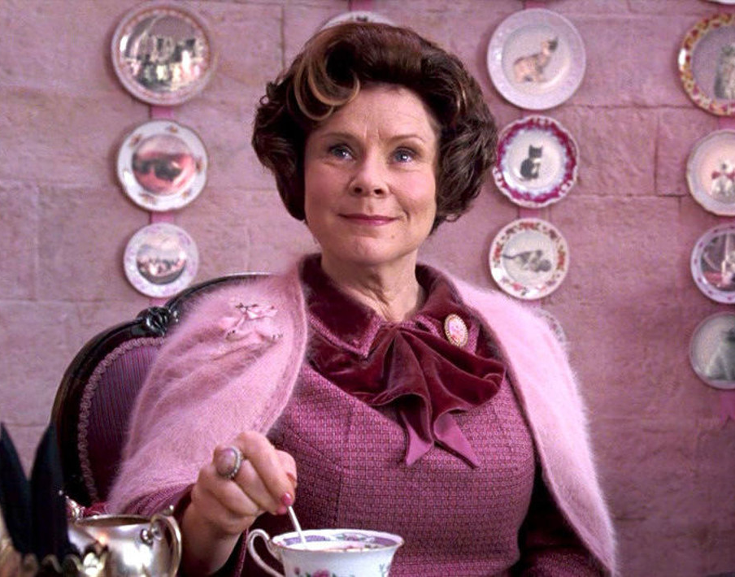
Bureaucratic
"Follow the rules“
Structure and procedure above
all else
This Photo by Unknown Author is licensed under CC BY-NC-ND
Enforces regulations to the letter
Notes:
1 mins​
0:19 – 0:20
​
Say​
Another pretty traditional leadership styles in bureaucratic. This style establishes a clear chain of command with defined roles and responsibilities. Bureaucratic leaders exhibit characteristics like being disciplined and organized, hard-working, and can be quite passionate. These leaders “follow the rules” and prioritize structure and procedure. One advantage to this style is how it reduces confusion and increases transparency, but it tends to be resistant to new ideas and change. We typically see this style in large, complex settings.
Click for example.
Dolores Umbridge, who just so happens to be a villain from the Harry Potter series, is in fact a bureaucratic leader. She is well known for intensely enforcing school regulations. Not all bureaucratic leadership presents as villains either. This leadership style is well suited to overseeing workplaces that are large in scale.
Source
Parsons, L. (2025, February 19). How to Determine What My Leadership Style Is - Professional & Executive Development | Harvard DCE. Professional & Executive Development | Harvard DCE. https://professional.dce.harvard.edu/blog/how-to-determine-what-my-leadership-style-is/#Leadership-Style-Types

Slide 10

Coaching
"Let me help you grow"
Individual development through mentorship
This Photo by Unknown Author is licensed under CC BY-NC-ND
Focuses on personal development and potential
Notes:
1 mins​
0:20 – 0:21
​
Say​
Now we get a little more personal with the coaching leadership style. Leaders who coach use a personalized approach to focus on staff members as people, helping them to improve their skills and build on existing strengths. We tend to see coaching leaders exercising compassion when working with staff saying “let me help you grow”. This can build deep connections with your staff, but it can be time consuming.
Click for example.
Yoda, a beloved coach and mentor from Star Wars, is a classic example of this leadership style. He pushes Luke Skywalker to be the best that he can be, holds him accountable, and provides support and guidance. While this is a great leadership style and one that your staff could significantly benefit from, it is important to keep in mind the time commitment that this leadership styles requires.
Source
Parsons, L. (2025, February 19). How to Determine What My Leadership Style Is - Professional & Executive Development | Harvard DCE. Professional & Executive Development | Harvard DCE. https://professional.dce.harvard.edu/blog/how-to-determine-what-my-leadership-style-is/#Leadership-Style-Types

Slide 11

Democratic
"Let's decide together"
Shared decision-making and collaboration
Values input from all in decision-making
Notes:
1 mins​
0:21 – 0:22
​
Say​
Democratic leaders rely on their teams to work together towards a decision. This is a great way to bring together the unique perspectives and talents of your staff to inform decisions that will ultimately affect them. Democratic leaders tend to see more staff engagement, but it can lead to a slower decision-making process. This type of leader thrives on working in teams.
Click for example.
Optimus Prime from Transformers is a prime democratic leadership example. He strives to includes his peers in the decision-making process. While not everyone will agree all the time, we can still hear out ideas and feedback from our teams and discuss together how to move forward.
Source
Parsons, L. (2025, February 19). How to Determine What My Leadership Style Is - Professional & Executive Development | Harvard DCE. Professional & Executive Development | Harvard DCE. https://professional.dce.harvard.edu/blog/how-to-determine-what-my-leadership-style-is/#Leadership-Style-Types

Slide 12
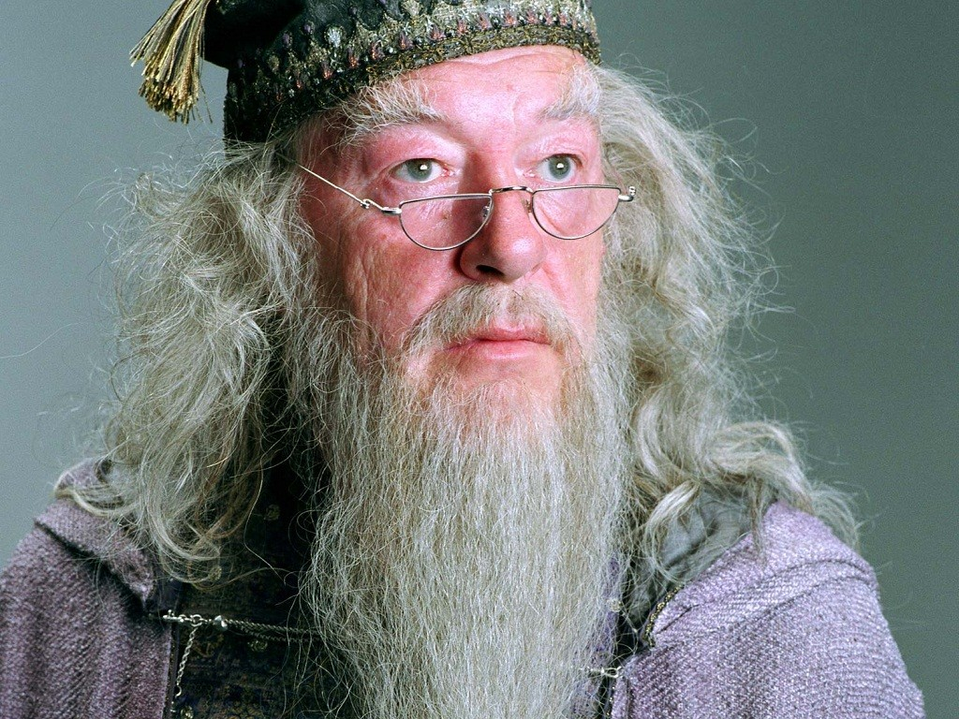
Laissez-faire
"You've got this“
Hands-off approach with full autonomy
This Photo by Unknown Author is licensed under CC BY-SA
Allows significant independence
Notes:
1 mins​
0:22 – 0:23
​
Say​
Laissez-faire is French for “let it happen”. This leadership style can be indicative of having significant trust in your team as these kinds of leaders take more of a hands-off approach allowing staff to work autonomously. This type of leader embraces a “you’ve got this” mindset. Laissez-faire leaders hold accountability for the work completed, delegate easily to their staff, and empower staff to make their own decisions. While this can really encourage growth and build self-esteem and confidence, keep in mind that without clear roles and responsibilities, this leadership style may cause some confusion for the team.
Click for example.
You may remember Professor Dumbledore from the Harry Potter series was pretty hands-off until he absolutely had to do otherwise. He allowed for significant independence for not just the faculty of Hogwarts, but even for the students at the school. While he had this approach, he also made it clear to everyone that help and support was always there if someone needed it.
Source
Parsons, L. (2025, February 19). How to Determine What My Leadership Style Is - Professional & Executive Development | Harvard DCE. Professional & Executive Development | Harvard DCE. https://professional.dce.harvard.edu/blog/how-to-determine-what-my-leadership-style-is/#Leadership-Style-Types

Slide 13

Servant
Listening
Empathy
Healing
Awareness
Persuasion
Conceptualization
Foresight
Stewardship
Supporting growth
Building community
"How can I serve you?“
Putting others’ needs first
Serves humanity and puts others first
Notes:
1 mins​
0:23 – 0:24
​
Say​
Servant leadership which we see a significant amount of in the OST space, is characterized by putting others first and asking “how can I serve you?” Servant leadership is broken down into 10 characteristics: listening, empathy, healing, awareness, persuasion, conceptualization, foresight, stewardship, supporting growth, and building community. These leaders are focused on empowering their teams to grow and succeed. This style does come with a significant time commitment for listening and committing to others and may not fit all workplaces.
Click for example.
Superman is a great example of a servant leader as he is committed to serving humanity and putting others in his life ahead of himself. A lot of superhero type characters are servant leaders, but so are many educators, health professionals, and even politicians as the crux of their work is rooted in serving others.
Source
The National Society of Leadership and Success. (n.d.). What is leadership: Understanding different leadership styles. https://www.nsls.org/understanding-different-leadership-styles

Slide 14

Visionary
"Follow me to the future“
Inspiring others toward a compelling vision
Envisions solutions for global problems
Notes:
1 mins​
0:24 – 0:25
​
Say​
Visionary leaders are always thinking about the future and work to bring along their teams into that envisioned future. They are inspirational, optimistic, and strategic. While they are certainly passionate, sometimes that passion can stifle others’ ideas or suggestions. Sometimes issues and challenges in the moment get pushed to the wayside while in pursuit of the end goal.
Click for example.
Tony Stark, also known as Iron Man, was a visionary leader. If you know anything about Iron Man’s origin, you know that Tony Stark was always a visionary, but prior to him becoming Iron Man, his vision for the future was perhaps misguided as it focused on business profits. As he grew into the beloved superhero, his vision became more humanitarian. That is all to say that the vision may change, but a visionary leader is always setting clear goals and drives their team to meet those goals.
Source
Parsons, L. (2025, February 19). How to Determine What My Leadership Style Is - Professional & Executive Development | Harvard DCE. Professional & Executive Development | Harvard DCE. https://professional.dce.harvard.edu/blog/how-to-determine-what-my-leadership-style-is/#Leadership-Style-Types

Slide 15

Transformational
"Be more than you thought possible“
Inspiring personal and organizational growth
This Photo by Unknown Author is licensed under CC BY-SA-NC
Transforms self and inspires others to challenge boundaries
Notes:
1 mins​
0:25 – 0:26
​
Say​
Just like a visionary leader, transformational leaders are highly inspirational. They want not only their organization to grow and succeed, they want their people to grow and succeed. Unlike a visionary leader, a transformational leader listens more to their team and values collaboration. This can be excellent for organizational morale. This style does take more of a time investment into the people on your team, but it’s all about pushing folks towards their potential and beyond.
Click for example.
Mulan, a legendary Chinese character depicted here from the Disney film, was a transformational leader. She not only transformed herself literally and figuratively, but she also helped to transform those around her, challenging her peers and challenging the boundaries in Chinese society and her community.
Source
The National Society of Leadership and Success. (n.d.). What is leadership: Understanding different leadership styles. https://www.nsls.org/understanding-different-leadership-styles

Slide 16
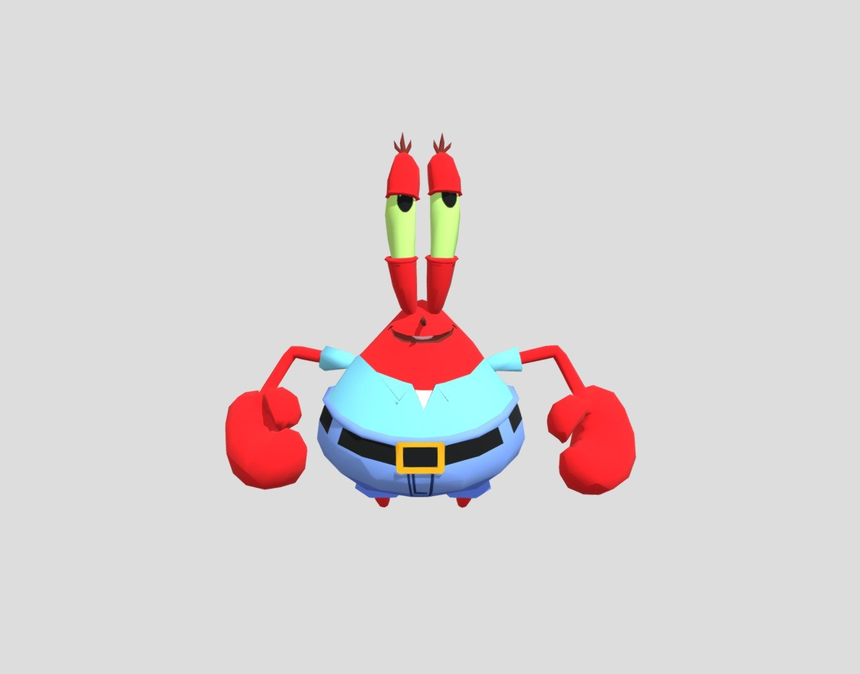
Transactional
"Do this, get that“
Clear exchanges of performance for rewards
This Photo by Unknown Author is licensed under CC BY
Focuses on rewards/penalties based on performance metrics
Notes:
1 mins​
0:26 – 0:27
​
Say​
Transactional leadership is a carrots and sticks kind of leadership style meaning that a leader uses rewards for desired outcomes and punitive measures for the not so desirable. Leaders of this style use incentivization to achieve staff goals. Transactional leaders use supervision, structure, and processes to support staff. There are pros and cons to this leadership style as it can have a positive impact on program operations, but it can produce misguided motivation in your staff.
Click for example.
Mr. Krabs, the owner of the Krusty Krab restaurant in SpongeBob SquarePants, is a classic transactional leader. He focuses on rewards and penalties based on the performance of his employees. He also is known to be quite miserly and cash-grabby. If you know the show, you can recall the kind of work environment his leadership style produced. When implemented with best intentions, this style isn’t all that bad. You just have to keep up on the checks and balances of staff motivation.
Source
Transactional and Transformational leadership styles: Pros and Cons. (2023, September 15). https://online.spalding.edu/blog/transactional-and-transformational-leadership-styles-pros-and-cons#:~:text=What%20Is%20Transactional%20Leadership?,transactional%20leadership%20approach%20in%20education.

Slide 17
Autocratic
Bureaucratic
Coaching
Democratic
Laissez-faire
Servant
Visionary
Transformational
Transactional
Notes:
5 mins​
0:27 – 0:32
​
Say​
There are more leadership styles, but regardless of which ones we’ve covered today, the fact of the matter is that you most likely exhibit multiple leadership styles. It is very common to both be servant leader minded, but also be in a bureaucratic environment. Or perhaps you are more of a transactional leader because that is what works best for you and your staff, but perhaps you are also a coaching leader helping to support and grow your staff so one day transactional motivation isn’t as necessary.
Activity- In-Person – Turn and Talk
Take a moment and turn to your neighbor and chat about which of these styles resonated with you and why.
Activity- Virtual – Annotation/Chat
Using your annotation tool, place a check mark, star, or other stamp on the leadership styles that resonated with you. You can also drop your answer in the chat.
Facilitators share which ones resonated with them while waiting for participant responses.
Debrief
Observe & Identify Concepts What leadership style do you feel is best suited to your OST work?
Apply How do you see your leadership style supporting your teams compared to the changes that you want to make to better support your teams?

Slide 18

Leadership Casting Call
If your leadership style was a play, what characters would be cast?
Notes:
5 mins​
0:32 – 0:37
​
Activity- In-person – Casting Sheet
Now that we’ve spent some time considering these different leadership styles and gone through some examples of characters who emulate those styles, its time for you to cast your own leadership play. Think about other characters who you may identify with and cast them in your show. These could be characters, but also think about real people throughout time. It could be important persons from history or even someone living today. Be sure to identify what leadership style they exhibit and why you’ve chosen them.
Activity – Virtual - Chat
Now that we’ve spent some time considering these different leadership styles and gone through some examples of characters who emulate those styles, its time for you to cast your own leadership play. Think about 1 to 3 characters who you may identify with and cast them in your show. These could be characters, but also think about real people throughout time. It could be important persons from history or even someone living today. Let us know what leadership style they exhibit. Drop us your answers in the chat.
Facilitators share their own “cast” while waiting for participants responses.
Debrief
Observe & Identify Concepts What does this selection reveal about your own leadership values and natural tendencies?
Apply Concepts​ Which of these leadership styles would be most effective in a specific situation you're facing right now?

Slide 19


Strengths and Weaknesses
?
Notes:
2 mins​
0:37 – 0:39
​
Say​
This brings us to our last piece of the puzzle today which is really all about identifying strengths and weaknesses. Recognizing your strengths allows you to position your expertise strategically and enhance team effectiveness, while acknowledging weaknesses offers a targeted path for growth. This brings us back to our earlier focus on self-awareness – awareness of strengths and weaknesses is integral to emotional intelligence and effective leadership.
Great leaders don’t simply rely on what they already do well; they know how to leverage those strengths to inspire others, build trust, and move their organizations forward. At the same time, they remain honest about the areas where they may fall short. Weaknesses are not signs of failure but opportunities to learn, adjust, and invite collaboration. In fact, leaders who openly acknowledge their growth areas often create cultures of transparency and continuous improvement.
Developing this balance requires intentional reflection and feedback. Self-assessment tools, 360-degree feedback, and mentorship can help us see patterns in our leadership style that might otherwise go unnoticed. From there, we can create plans that both amplify our strengths and mitigate our weaknesses.
Ultimately, leadership is less about being perfect and more about being adaptive. By embracing both sides—what comes naturally and what challenges us—we position ourselves for sustainable growth. You’ll have a chance to take a deeper look at your own leadership landscape, identifying where your strengths can shine and where your weaknesses may hold untapped potential for growth.

Slide 20
Personal SWOT Analysis
Strengths | Opportunities
Weaknesses | Threats
Negative Positive
Internal External
Notes:
4 mins​
0:39 – 0:43
​
Say​
To put this into practice, we will use a tool called the SWOT analysis. SWOT stands for Strengths, Weaknesses, Opportunities, and Threats, and it offers a structured way to think about yourself as a leader. This can be a powerful tool for personal and professional growth because it helps you see the bigger picture—what you bring to the table, what may hold you back, and how your environment shapes your leadership journey.
The strengths quadrant is where you identify the qualities, skills, and behaviors that make you effective. These are internal as they are truly about yourself, and they are positive in nature. This could be strong communication, problem-solving, or the ability to motivate others. The weaknesses quadrant is an honest look at the areas that need attention—perhaps difficulty delegating, avoiding conflict, or struggling with time management. These are still internal as you own your weaknesses, but these are more negative in nature.
The opportunities quadrant focuses on external factors that can support your growth and they are positive, value-added opportunities. This might include mentorship, professional development programs, or upcoming projects that align with your strengths. The threats quadrant highlights external challenges that may hinder progress—such as organizational changes, limited resources, or competing priorities. These things are negative in nature.
By taking time to reflect across all four areas, you gain a holistic view of where you stand today and where you want to go. A SWOT analysis helps you connect self-awareness with action, showing not only what is working but also what needs attention, and how to align your leadership with opportunities for growth. We’re going to spend some time on this today.
Activity - In-person and virtual – SWOT analysis
As we get ready to dive in, grab a piece of paper and something to write with. You’ll want to section off your piece of paper into four quadrants like displayed here. We’re going to guide you through some questions for each of the quadrants. As we do, think about your answer and jot it down in the corresponding quadrant. Ready? Let’s begin.

Slide 21


Strengths
What leadership qualities energize you—e.g., communication, empathy, decisiveness?
What feedback highlights your top capabilities?
Which strengths do you rely on to lead effectively?
Notes:
2 mins​
0:43 – 0:45
​
​Activity
Note for facilitator: Music will play in the background on slides 23-26.
Facilitator reads the questions spaced approximately 30 seconds between each one.

Slide 22

Weaknesses
Which behaviors or mindsets hold you back—e.g., reluctance to delegate or risk aversion?
Where have you received constructive criticism?
What patterns do you notice in challenging leadership moments?
Notes:
2 mins​
0:45 – 0:47
​
​Activity
Facilitator reads the questions spaced approximately 30 seconds between each one

Slide 23

Opportunities
What future leadership development opportunities exist—coaching, new roles, stretch assignments?
Can you align your strengths to emerging initiatives?
Who in your network could broaden your perspective or help elevate your growth?
Notes:
2 mins​
0:47 – 0:49
​
​Activity
Facilitator reads the questions spaced approximately 30 seconds between each one

Slide 24

Threats
What organizational or environmental changes could challenge your effectiveness?
Are there habits or systemic pressures that might amplify your weaknesses?
How might external expectations strain your current strengths?
Notes:
2 mins​
0:49 – 0:51
​
​Activity
Facilitator reads the questions spaced approximately 30 seconds between each one
Debrief
Observe & Identify Concepts What did you discover about yourself as a leader that you hadn’t fully recognized before?
Apply Concepts How can you use the insights from your SWOT analysis to guide your next steps in leadership—whether that means leveraging a strength, addressing a weakness, or pursuing an opportunity?

Slide 25
Start
What practice do you want to begin that will bring fresh energy and growth to your role?
Stop
What commitment or routine drains your energy and keeps you from leading effectively?
Continue
How can you amplify or build on the approaches that are already working well?
Notes:
5 mins​
0:51 – 0:56
​
Activity – In-person – Discussion
As we being to wrap up today, we want to take a moment for you to take all that we’ve discussed today and think about what you want to start, stop, and continue. ​As you think about these guiding questions, hone in on one and discuss with a neighbor. We’ll come together in a few minutes to share out.
Activity – Virtual – Chat/Unmute
As we being to wrap up today, we want to take a moment for you to take all that we’ve discussed today and think about what you want to start, stop, and continue. ​As you think about these guiding questions, hone in on one and drop us your answer in the chat, or we welcome you to unmute and share aloud.
Debrief
Observe & Identify Concepts How do your start, stop, and continue choices work together to strengthen your leadership style?
Apply Concepts How might your start, stop, and continue choices positively impact the people you lead or collaborate with?
Source
Peters, B. (2025b, January 10). Three Tools for Self-Reflection — The Leadership Coaching Lab. The Leadership Coaching Lab. https://www.theleadershipcoachinglab.com/blog/tools-for-reflection

Slide 26
Keep It Going
Jump on an opportunity from your SWOT analysis
Get started trying something new
Stop something that isn’t serving you or your program anymore
Notes:
0:56-1:00
Say
As we leave you today, we want you to think about these three things to take what you’ve learned today and keep the momentum going.
Think about the opportunities you identified in the SWOT analysis and take it
Identify something new that you want to start doing in your practice
Stop doing whatever isn’t working for you and isn’t serving you, your staff, or your program.

