Slide 1
Trainer Action Pack
A Guide to the Session
Notes:
About this Action Pack
This session takes 60 minutes. The session includes information for you the presenter, activities for participants, and a debrief for each activity.
Notes Section
In the notes section, you will find a complete guide to each slide including timing, what to say, related activities and debriefs. You can read from the notes like a script or feel free to adapt and add to the content to make it relevant for your program. One thing to note is that instructions in italics are instructions to you, the presenter.
Activities
There are instructions throughout the session for both in-person and virtual versions of the activities. Use whichever format best suits your implementation of the session.
Debrief
Debriefs follow each activity and are comprised of two parts: Observe & Identify Concepts and Apply Concepts.
Observe & Identify: As the facilitator of the session, observe participants during the activity and be prepared to comment on your observations. Participants should identify concepts from the activity and discuss.
Apply Concepts: The last part of the debrief is taking the identified concepts and having participants discuss applying those concepts to the context of your program.
How to Adapt this Session
You can expand this session by:
Spending more time on the activities as needed or desired.
Adapting the examples and scenarios to align with your program.

Slide 2
Culture By Design
Building an Environment Where Youth Thrive
Notes:
Say​​
Great program culture doesn't just happen - it's built step by step over time. This session shows you how to create a positive environment where youth actually want to be. You'll learn practical ways to discover youth interests, create group norms, and give youth a voice and a choice to foster belonging and engagement. These elements help create a space where youth feel valued and want to participate.
Materials
If you are facilitating this training in-person:
Norm or Not displays (1 copy)
Timer or use the countdown videos below
60 second countdown with music - https://youtu.be/mqH_WHjYoIU
20 second countdown with bell - https://youtube.com/shorts/6cftwFGMrdY?si=dZWPyC1U6AP5RthC
1 index card* or strip with grade levels on them for each table. Use whichever you feel is most relevant.
Suggestions are K-2, 3-5, 6-8, 9-12
Presentation pad/board with grade levels referenced above written as headings (either one per presentation pad or per column on the board)
Markers appropriate for the surface
Voice-and-Choice-O-meter statement signs (1 copy)*
5 Senses Belonging Audit statements*
Survey Response cards (1 set per participant)*
Audio and Wi-Fi to play videos
*These items may be downloaded here - https://drive.google.com/drive/folders/1l1mazuveN8v_BNxWdFCTrde-bx8Ku1pj?usp=sharing
If you are facilitating this training virtually:
Audio to play videos
Prepare the poll on slide 16

Slide 3

The Power of Positive Environments
Engaging and empowering
Physical, emotional, psychological safety
Seen, respected, and cared for
Strong skill development
Agency, self-love, and pride
Empathy and meaningful connections
Notes:
2 mins
0:05-0:07
Say
Your program culture and climate are keys to supporting youth and maintaining youth engagement. Every youth in your program should experience engaging and empowering learning opportunities; physical, emotional, and psychological safety; and they should feel seen, respected, and cared for by their peers and the program adults.
Click to display second list.
When we create a positive environment for youth, the results are indisputable. We see strong skill development, both academic and non-academic skills. Youth develop a sense of agency, self-love, and pride in themselves and their work. Youth build meaningful connections with peers and adults in positive program environments which in turns helps them to build empathy.
Source
https://schoolguide.casel.org/focus-area-3/classroom/a-supportive-classroom-environment/

Slide 4
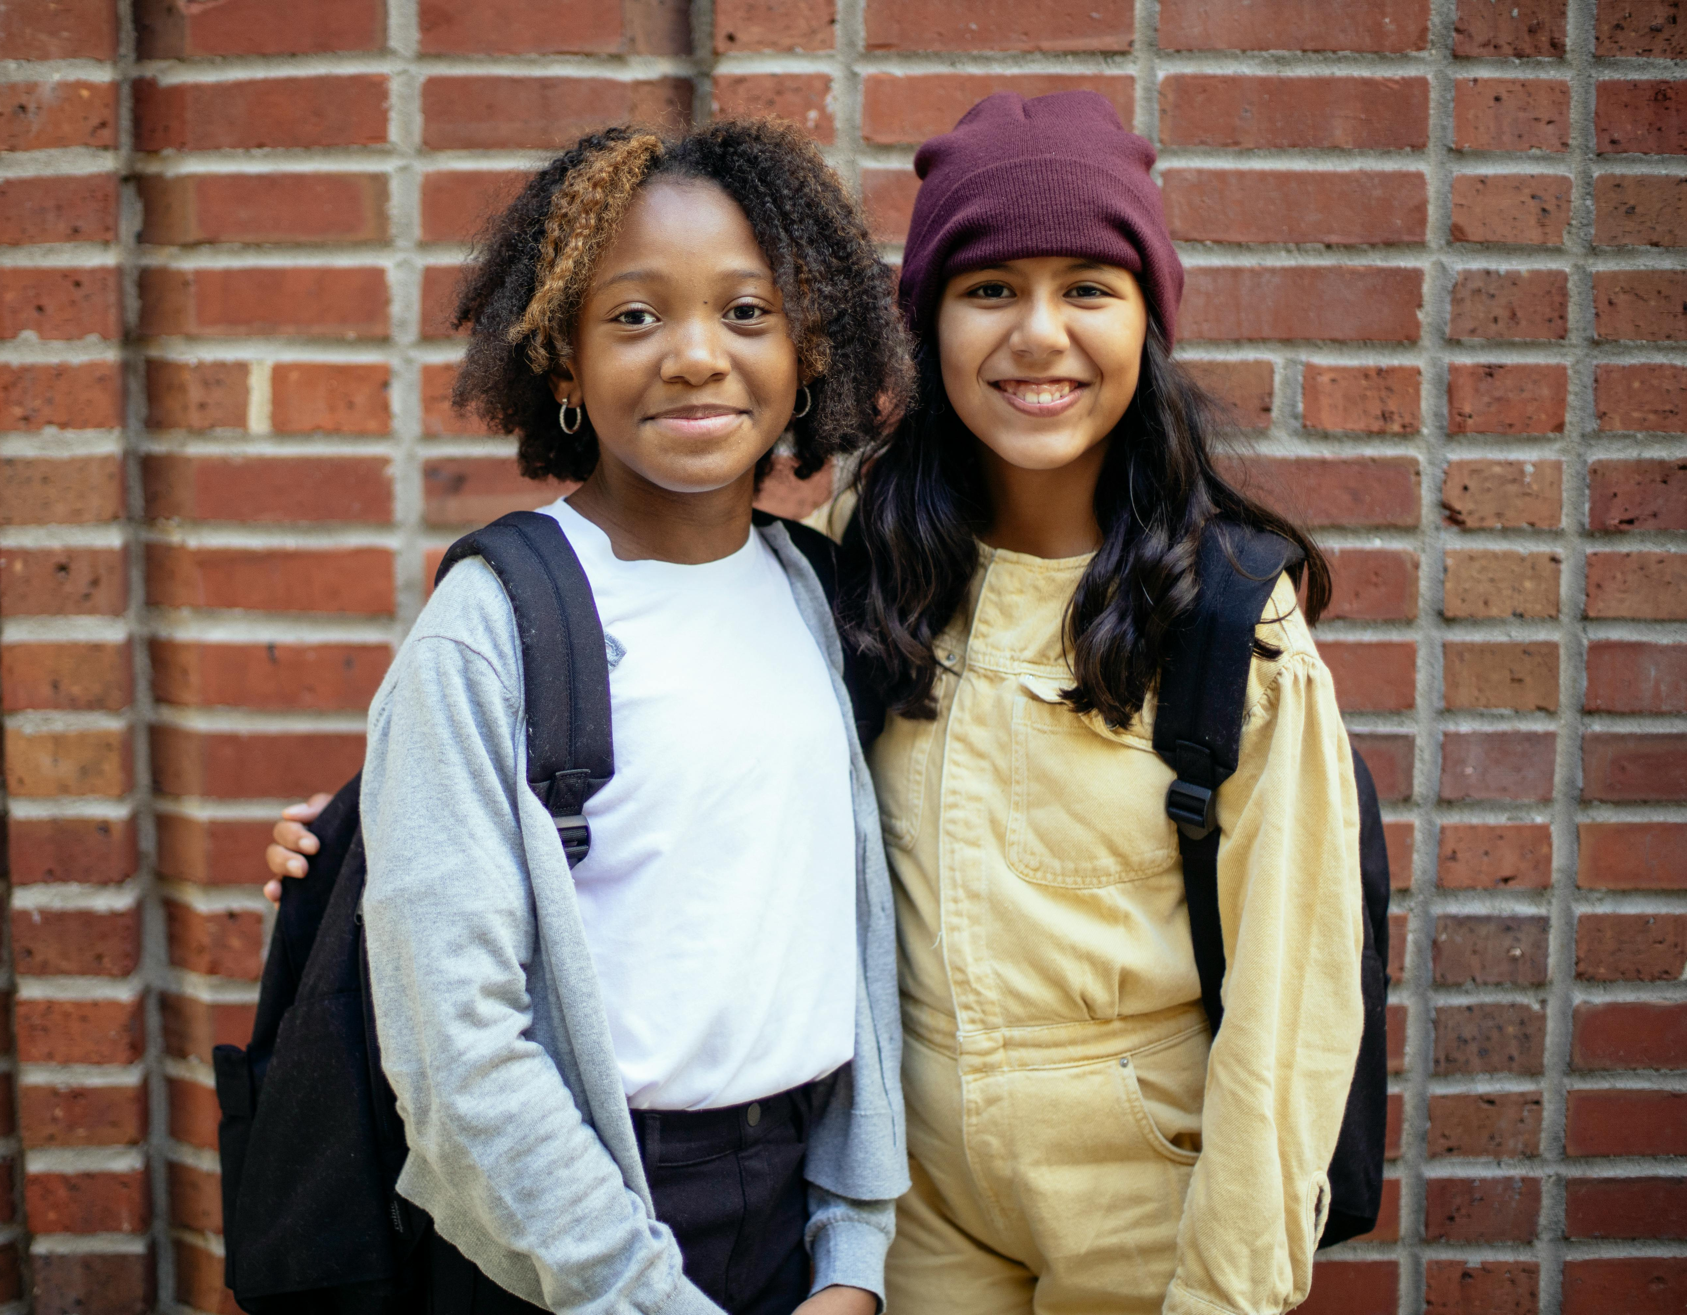
Design the Environment
Develop expectations together using group norms
Incorporate youth voice and choice
Build belonging
Notes:
1 mins
0:07-0:08
​
Say​
As we work on creating a positive learning environment, there are several things we can do. You can develop expectations in partnership with youth through group norms. Increase the learning potential by incorporating youth voice and choice into all program aspects. Ultimately its about belonging.
We’ll dive into each of these deeper today.

Slide 5
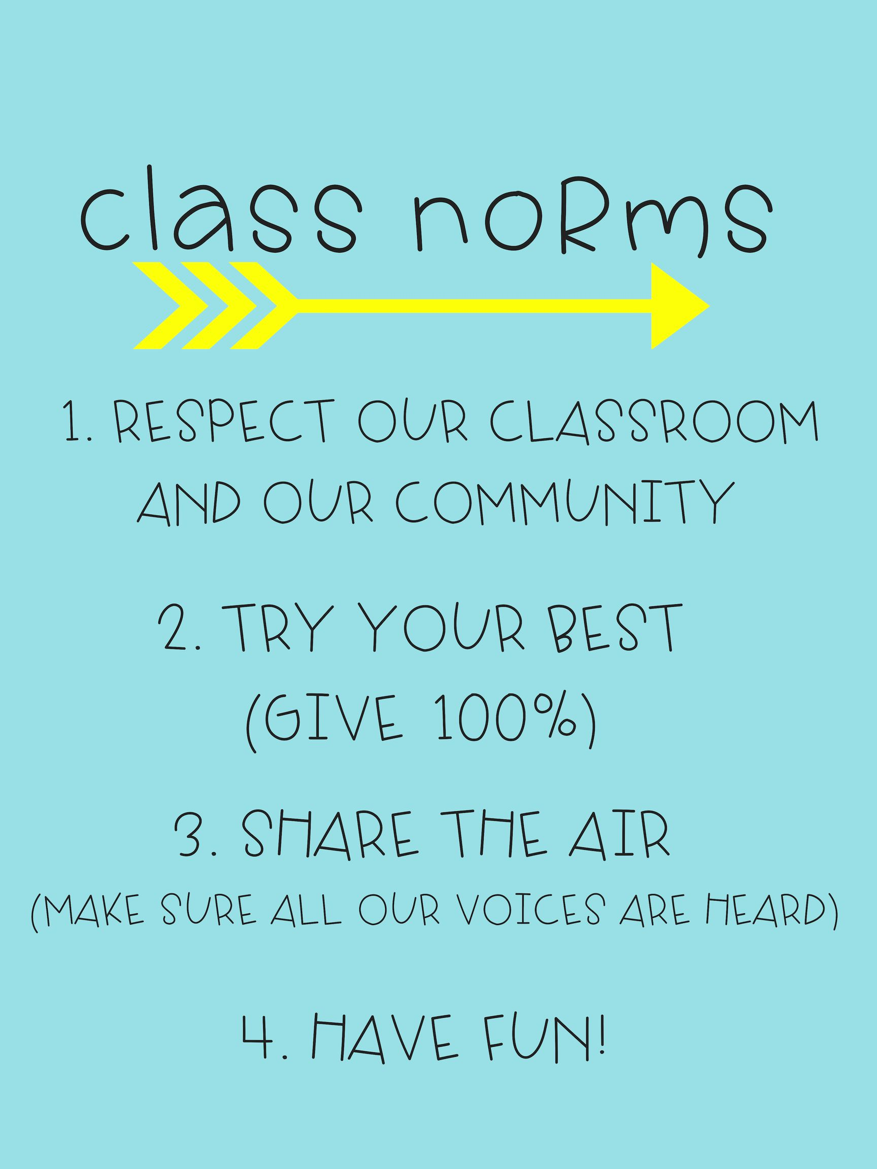
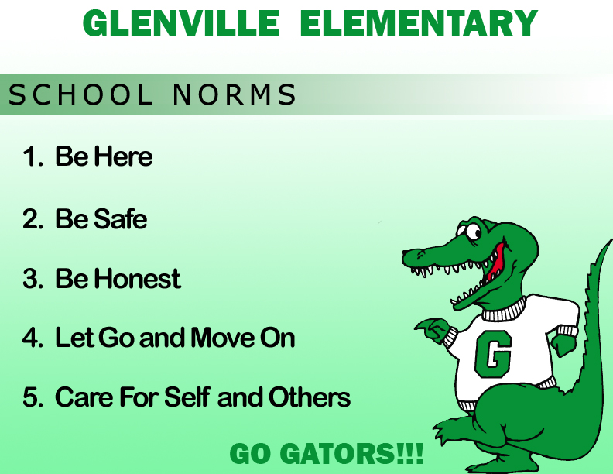
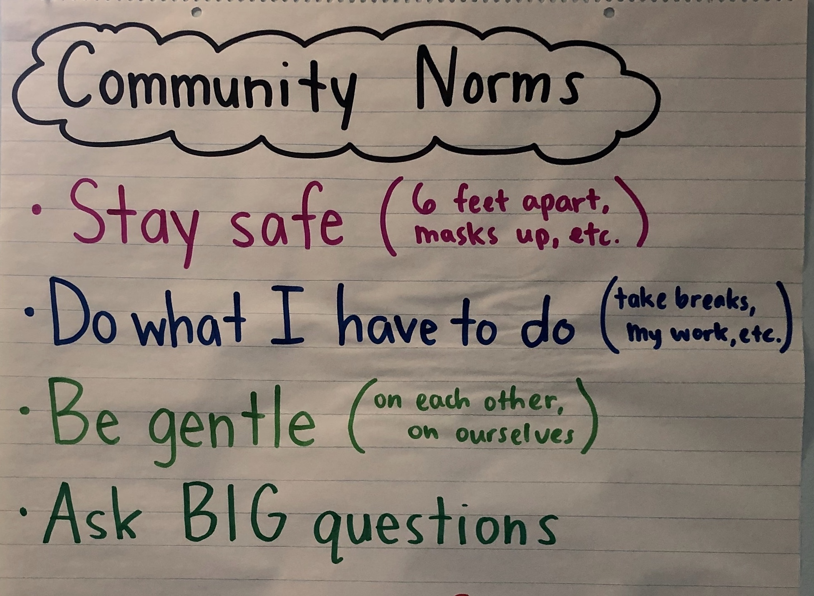
What are Group Norms?
Not rules
5-7 positive statements
Agreed upon expectations
Guide behavior and social interactions
Notes:
2 mins
0:08-0:10
Say
Animations occur automatically.
One way we can go about creating a positive environment is by creating norms for learning. This is a great thing to do with youth. Having their input in what the norms should be help them to buy into the culture they helped design. Norms are different from the rules you enforce in your program. Norms are 3-7 statements that explain how youths and staff interact with one another. They are agreed upon expectations that guide behavior and social interactions.
Have you ever been in a class or activity where you’ve felt frustrated because you can’t get a word in? Or you or others hang back and don’t participate? Have you ever felt attacked by what someone says to you? Norms develop whether you are intentional about creating them or not, but in these scenarios the norms that have developed are not ones that create a positive environment for youths.
To avoid this, taking time to intentionally form norms at the beginning of the program or even an activity and continuing to revisit them consistently will create a more effective, positive learning environment.

Slide 6
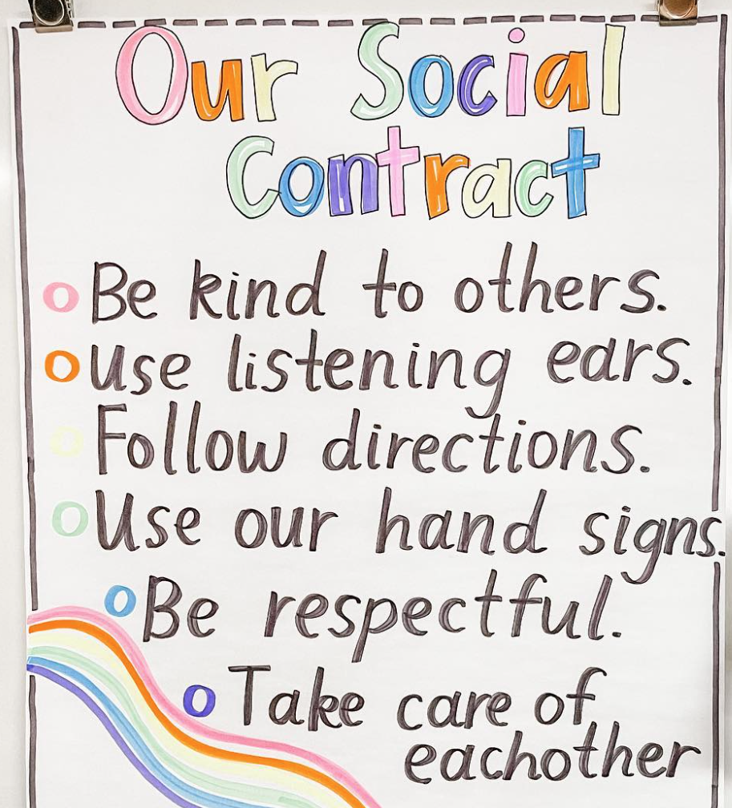
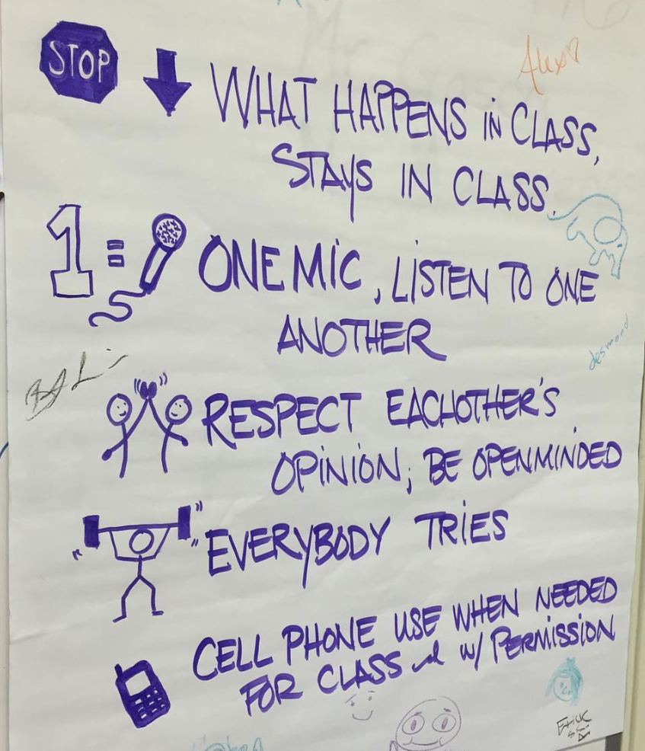
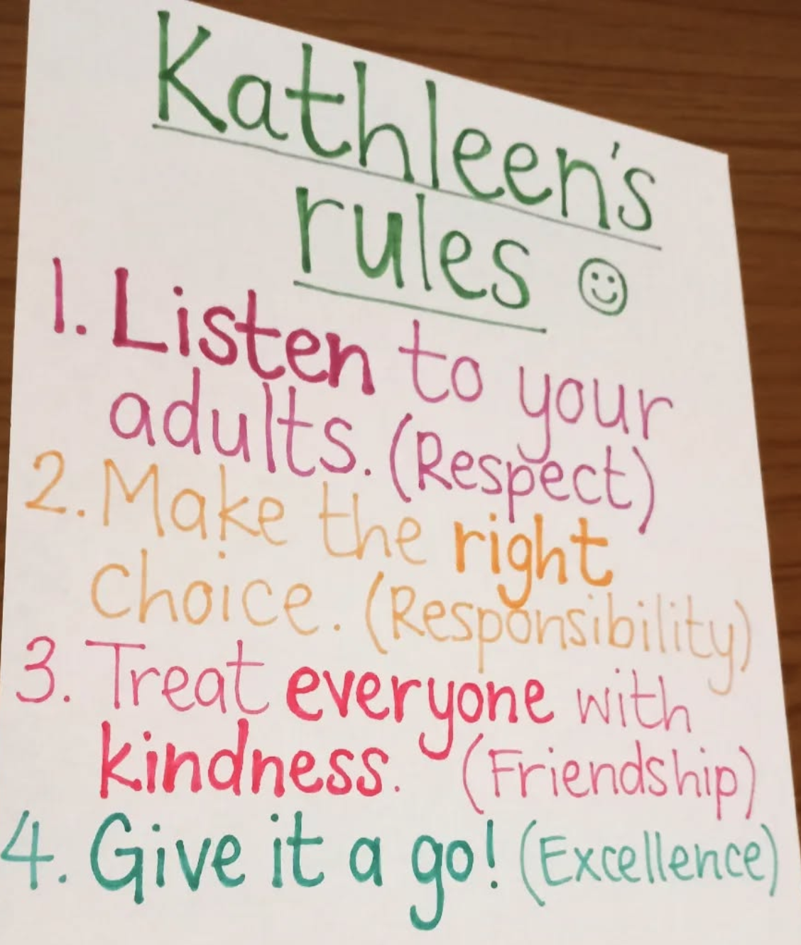
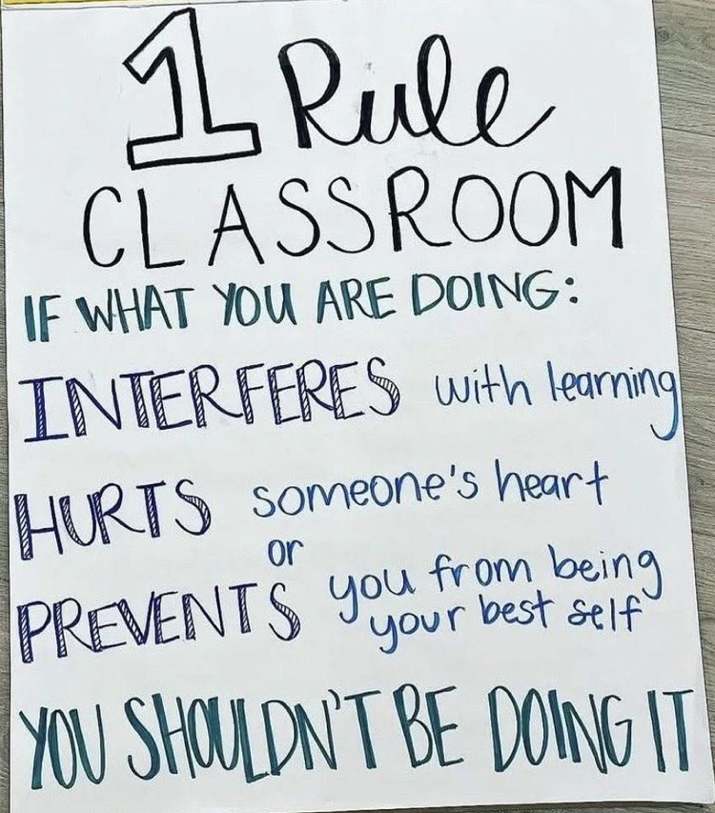
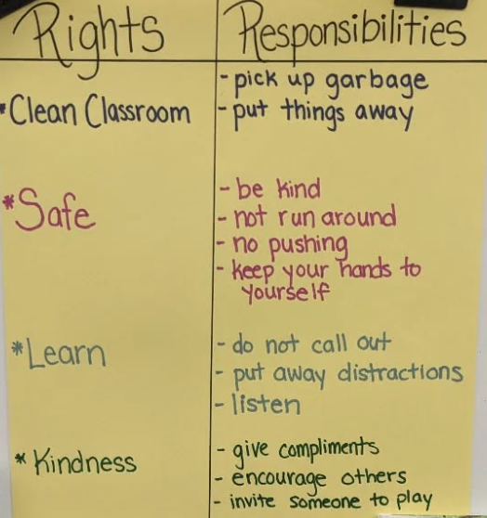
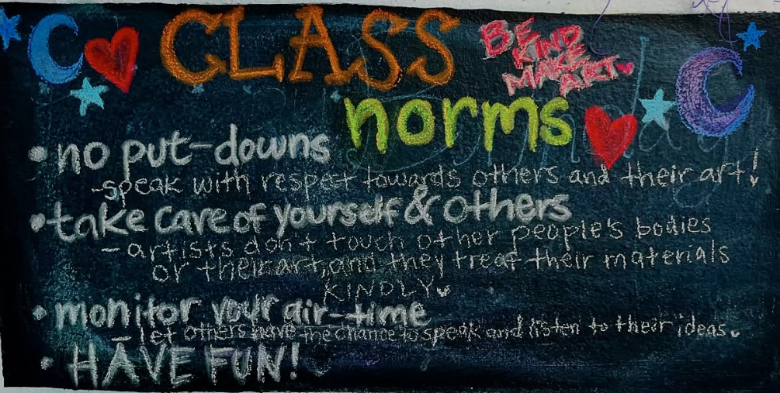
Rule vs. Norm
Norm
Rule
Notes:
5 mins
0:11-0:16
In-Person Activity – Norm or Not
Decide how to divide the group into 6 smaller groups. Distribute 1 of the 6 images to each group and ask them not to look at them until instructed.
Let’s play a game called Norm or Not. Each group has a sheet with some rules and norms displays. As a group, you will have 60 seconds to decide if the display lists norms using the descriptions we have discussed. If your group decides that the display does not list norms, explain why and come up with suggestions for transforming them into norms. Be careful though, some may say norms, but really are more like rules. Each group will have 20 seconds to report out at the end of the 60 seconds. So, choose a spokesperson now and be ready to jump right in when I say “GO”.
You can use your own timer to keep time or the countdowns at the links below
60 second countdown with music - https://youtu.be/mqH_WHjYoIU
20 second countdown with bell - https://youtube.com/shorts/6cftwFGMrdY?si=dZWPyC1U6AP5RthC
Virtual Activity – Annotation
Let’s play a game! This is Rule vs. Norm. We’re going to look at some rules and norms displays. Some may even say rules or norms on them. Your job is to determine what they actually are. Use your annotation tool (or tell us in the chat) what you think each one is. Be careful though, some may say norms, but really are more like rules.
Click through the 6 images. Allow time for participants to respond between each. Comment on what makes them rules vs. norms.
Debrief
Observe & Identify Concepts Comment on responses. What makes a rule and what makes a norm?
Apply What do you use in your program and how can you adapt rules to be more like norms?
Sources
https://www.instagram.com/p/CxYv2tiAwmj/?igsh=OGFkZGVqb2NnZXk2
https://www.instagram.com/p/CgKPJZOOX3Y/?igsh=MTQ1Mm16ZWp2NDNmZg==
https://www.instagram.com/p/CiQ9sg8vrQE/?igsh=MXFmM21ydGtoOGZtNw==
https://www.instagram.com/p/BKH8BImDsku/?igsh=MXBrOGdib2l5dHZyZg==
https://www.instagram.com/p/DGPDbalS3fg/?igsh=MWFpa3hxdjlsZGY3dA==

Slide 7
Creating Group Norms
Involve Youth in the Process​​ | Discuss the Importance​ | Tailor to the Program ​
What are rules? What are norms? ​ ​ What is the purpose of norms? ​ | Why do we need group norms?​ ​ Why must we agree on the norms?​​ | How do we show kindness and respect?​ ​ ​ How do you know you’re safe? ​
Notes:
2 minutes
0:16-0:18
Say
So how do we get started with norms? Creating norms is a process and a conversation that you should include youth in.
Involve Youth in the Process – Engage youth in creating norms to ensure they feel invested and responsible for upholding them. Asking questions like what’s the difference between a rule and a norm – helps youth understand that rules are formal and set by organizations or institutions whereas norms are informal social agreements within the group. What’s the purpose of a rule? What’s the purpose of a norm? may be explained like this – a rule might be that youths can’t hit each other to ensure safety, while a norm might be treating each other with kindness to create emotional safety and belonging.
Discuss the Importance of Norms – Emphasize the importance of agreed-upon norms and how it helps to maintain a positive and respectful environment where everyone feels safe and valued.
Tailor Norms to the Program – The last portion of questions are geared towards specific youth experiences and preferences to tailor norms to your program space. Review questions
Once you’ve gotten a chance to discuss these questions with youth its time to agree on norms.

Slide 8
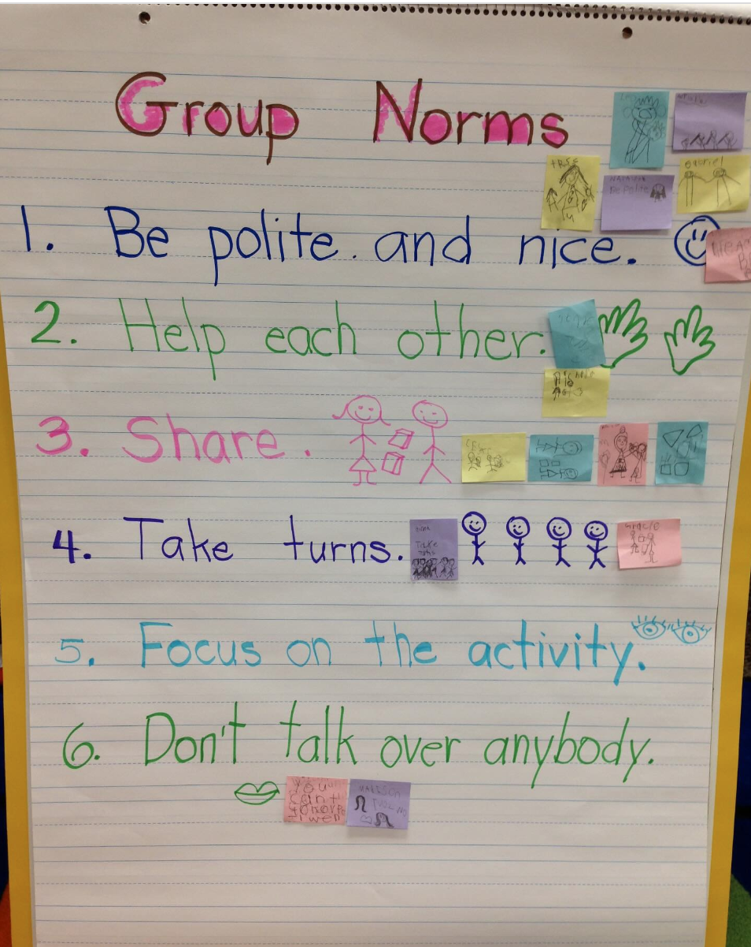
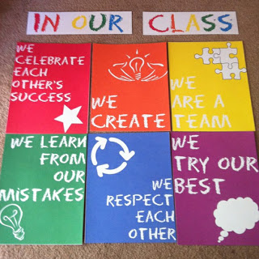
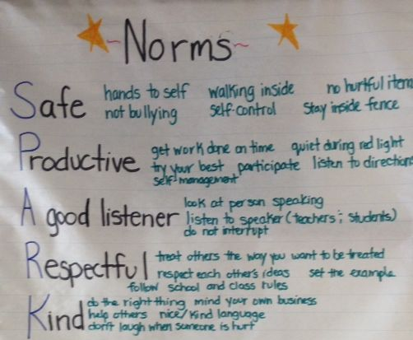
How to Form Norms
Gather ideas
Organize and refine ideas
Vote on norms
Demonstrate commitment
Notes:
2 mins
0:18-0:20
Say
Animations occur automatically.
After having these discussion with youth, now its time to form the norms.
First, gathering ideas – norms that your youth think you should use. Have them work independently or in small groups to brainstorm as many ideas as possible.
Then, organize and refine ideas. Help youth sort ideas. You may find that you have a lot of the same idea using slightly different words. Group these together. Have youth work together to discuss how they want to word their ideas and issues.
Vote on the norms to determine which will be used and if you all will be able to commit to these. You may find some that are controversial and should not be included in your final norms.
Finally, have youth demonstrate commitment to the norms. This can be by signing them or other processes.
We have seen several examples of norms – some are simple, others are more detailed or “beautiful”. No matter what your norms look like, they will be most effective if you develop them with youth and ensure everyone understands and agrees with them.

Slide 9

Adults in our program will...
Flipping the Perspective
Notes:
5 mins
0:20-0:25
In-Person Activity – Youth Voice on Adult Norms
Place a notecard on each table with one of the following on it (K-2, 3-5, 6-8, 9-12)
We’re going to flip the script a little and think about norms from a different perspective for a few moments. You have a card on your table that represents a grade level OSTs may serve. At your table, imagine you are youth in that grade level that have been coming to this program for 3 months. You’ve seen how adults interact with you and your peers. As a group, come up with 2-3 norms that the ADULTS have to follow and write them on the pad/board that matches the grade level you have.
Virtual Activity – Chat
We’re going to flip the script a little and place ourselves in a different perspective for a few moments. Imagine you are a 14-year-old who has been coming to this program for 3 months. You've seen how adults interact with you and your peers. If you could write group norms that the ADULTS had to follow, what would you include? Click for animation. Take a moment to think about this and then finish the statement on the screen. Drop your norm in the chat.
Suggest possible answers.
Adults will learn and use our names correctly, even if it takes practice.
Adults will ask us why we're upset before assuming we're being difficult.
Adults will include us in decisions about activities, not just tell us what we're doing.
Adults will remember things we tell them about our lives and follow up on them.
Debrief
Observe & Identify Concepts What patterns emerged in the norms youth would want for adults? How do these differ from typical group norms focused on youth behavior?
Apply What would change in your program if you actually implemented these norms?

Slide 10

What is Voice and Choice?
Expression of values, beliefs, opinions, and interests
Empowerment to make decisions and lead in activities
Notes:
2 mins
0:25-0:27
​
Say
Youth voice and choice is young peoples’ expression of their own values, beliefs, opinions, and interests being integrated into program design and empowerment to make decisions and lead within program activities.
Youth voice and choice is more than just talking to them about themselves and having positive relationships with them. It is the integration of their voice (their values, beliefs, and opinions) and choice (decisions) into your program and activities.
For more on this topic you may want to listen to the first episode of Podcast+ with The Dash entitled, Youth as Partners: Building Programs Where Youth Voice Drives Engagement now available on Spotify and Apple Podcasts using the links I’ve dropped in the chat (if virtual) or QR codes on the handout/sign (if in person). You will hear from two Philadelphia OST professionals, Mrs. Gina Williams – McBride and Mrs. Jennifer Ballard, who share examples of how they incorporate youth voice and choice in their program through Youth – Adult Partnerships.
Apple Podcasts
https://podcasts.apple.com/us/podcast/youth-as-partners-building-programs-where-youth-voice/id1815806475?i=1000719514152
Spotify
https://open.spotify.com/episode/66jKn9psk1Me5YLzNIec7D?si=fFv606VPRU6TkrVD6ucdjQ

Slide 11
Why Voice and Choice?
Compliance
Engagement
Empowerment
Notes:
2 mins
0:27-0:29
​
Say
Perhaps you are asking yourself aren’t positive relationships enough, or why is it important to have youth voice and choice in the program. You do lots of fun things in your program and youth love it!
Positive relationships with youth are key to group management and getting kids to do what you want them to – that’s compliance. But we want more than that for our programs. For youths to truly engage in learning and developmental activities they need to be interested in what they are doing, they need to be engaged. The only way to make sure that all young peoples stay engaged in every activity, is by giving them voice and choice. Voice and choice has one additional impact – when done effectively, it empowers youth to lead, to manage their own learning, and to make a difference in their program and community.

Slide 12
How to Incorporate Choice
What
What they will learn
Why
Why they will learn it
Who
Who they will work with
Where
Where they will work
When
When they will complete it
Notes:
3 mins
0:29-0:32​
​
Say
So how do we give more choice? We already talked about one way which is having youth help develop the norms for your program.
We can also provide youth choice 5 different ways.
What – Young people can have choice in what they will learn. Sometimes this is possible, other times it is not, but whenever we allow youth to choose the topics they will explore to develop a skill increases choice.
Why – Young people want to know why they’re learning information, and we often work to make learning relevant, but don’t forget to ask them why they are learning skills (and then use this to facilitate the activities). Have them engage by saying “I will learn this in order to…”
Who – Young people can and should choose who they work with. This can be social, but it should be intentional too. Help them select who they will work with using prompts such as:
Who do you need to help?
Who can you help?
What are your strengths?
What are your areas for growth?
Where – Young people shouldn’t have to learn all in the same place. For some desks help, others may want to sit on the floor, some may need to leave the classroom. Consider the set-up of your spaces, when you have flexibility – and you may not always – can you create quiet spaces, group work spaces, makerspaces, floor space, etc.
When – As youth choice in learning occurs, we need to be flexible about when they learn – when a project is complete or for how long they work on the same project at a time.

Slide 13

Voice-and-Choice-O-Meter
Notes:
5 mins
0:32-0:37
In-Person Activity – Voice-and-Choice-O-Meter
Have you considered how much you lean into youth voice and choice? There are 5 statements around youth voice and choice posted around the room. I will read each statement. Once I have read them go to the statement that resonates with your experience in the program most, and discuss with others the specific actions you or other staff at the program have taken to facilitate the outcome the statement speaks to. Use a marker to list these under the statement.
Virtual Activity – Chat/Reactions
Have you considered how much you lean into youth voice and choice? We’re going to share a few statements around youth voice and choice. If the statement resonates with your experience in the program, share a positive reaction such as a heart or a thumbs up. You can use Zoom’s reactions or drop an emoji or yes/no in the chat.
Click to move the meter after each statement.
Youth regularly propose new activities and lead the planning process to make them happen in our program.
Youth create and enforce their own group agreements, taking ownership of program culture and accountability systems.
Youth have transformed your physical spaces by creating areas that match different learning styles and social needs.
Youth evaluate program activities and make recommendations that result in schedule changes, new offerings, and modified approaches.
When conflicts arise, youth facilitate peer mediation sessions and develop their own solutions with minimal adult intervention.
Debrief
Observe & Identify Concepts Comment on responses. What statement resonated with you and your program the most?
Apply How can your program incorporate more voice and choice?

Slide 14
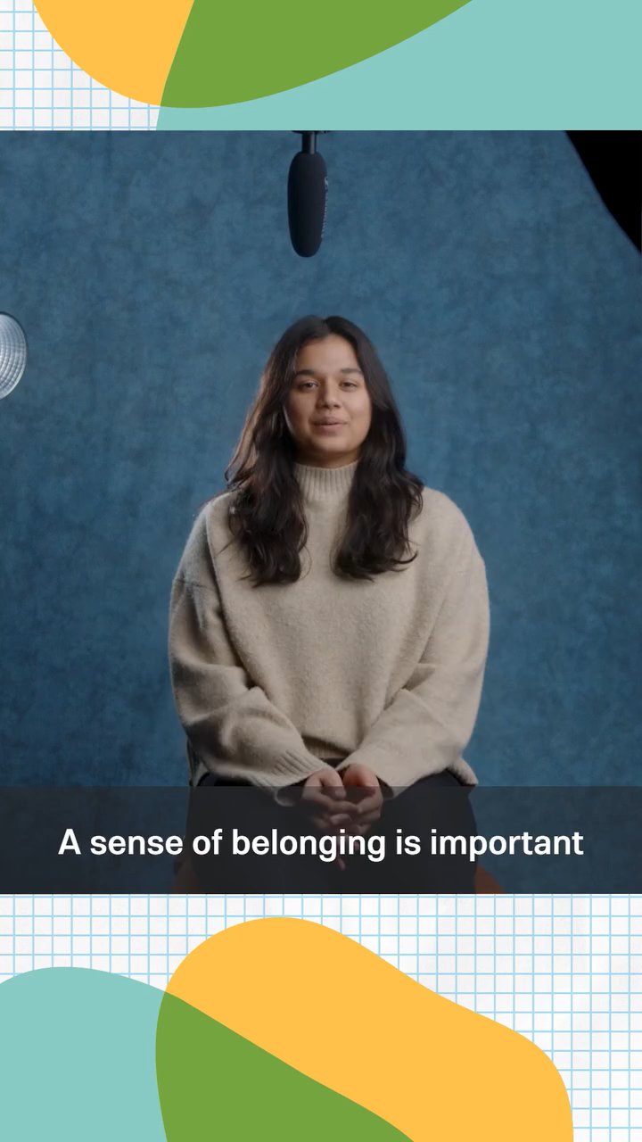
Belonging Matters
Notes:
2 mins
0:39-0:41
Say
All of this leads up to one of the most important things that youth need. They need to feel like they belong. Don’t take our word for it, though. Here are some high school youth sharing why belonging is important for them.
Click to play video.
Source
https://www.instagram.com/reel/DAEVTONNOA2/

Slide 15





The 5 “Senses” of Belonging
“I see myself reflected.”
“I don't have to pretend;
I can just be me."
“When I speak up, people really listen.”
“I get to try being a leader here.”
“I feel safe here.”
Notes:
5 mins
0:41-0:46
Say
So, if everything we’ve been talking about supports belonging, what else can programs do to make sure that it truly is a positive environment? We can consider the 5 “senses” of belonging. Click to reveal 5 senses.
In many ways, these 5 “senses” are metaphorical. We most certainly can see and hear things in programs that impact belonging, but how exactly should each of these present themselves in programming? Let’s dive into each. Click to display quotes for each as you speak.
Sight – Youth need to see themselves reflected in their environment. This means their cultures, identities, and interests are visible in program materials, wall displays, and activities. They also see welcoming body language from adults - eye contact, open postures, and genuine smiles. The physical space itself should be arranged to promote connection.
Sound – Belonging has an auditory dimension where youth hear their names used positively and pronounced correctly. They hear inclusive language, questions that value their input, and conversations that invite their perspectives. The overall sound of the program should include youth laughter, collaborative discussion, and voices sharing ideas rather than just adult instructions.
Touch – This includes both physical comfort (appropriate, culturally-sensitive gestures like high-fives) and emotional safety. Youth feel relaxed in their bodies, not hypervigilant or tense. They experience the "felt sense" of being known when adults remember personal details and check in on their wellbeing.
Taste – Beyond literal food, "taste" represents youth getting a sample or preview of their own potential and possibilities. When they belong, youth taste success, leadership, and capability in small moments that build their confidence. They get a taste of being valued contributors rather than just program recipients. They taste the sweetness of having their ideas implemented and the satisfaction of meaningful work. Programs should let youth taste different roles, responsibilities, and opportunities so they can discover their own preferences and strengths.
Smell – "Smell" captures the intangible atmosphere that youth sense immediately upon entering a space - what we might call the program's "vibe" or culture. Youth can smell authenticity versus performative inclusion. They can detect whether adults genuinely care about them or are just doing their jobs. This sense picks up on unspoken tensions, hidden biases, or conversely, the warm scent of genuine acceptance. Youth smell safety - not just physical safety, but emotional and cultural safety. They can sense whether the environment will nurture their authentic selves or require them to mask parts of their identity. Like how we can smell home cooking from down the street, youth smell belonging before they even fully experience it.

Slide 16




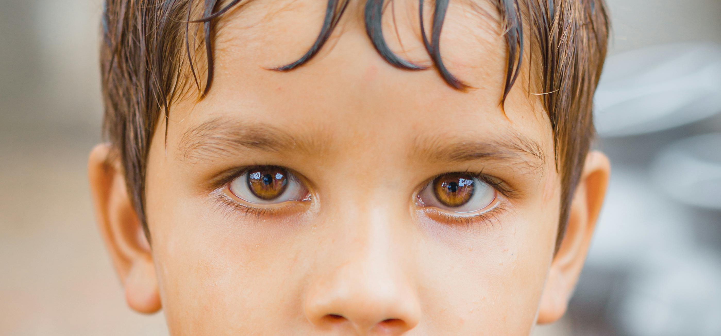

5 Senses Belonging Audit
Notes:
7 mins
0:46-0:53
In-Person Activity – Reflection Activity
As we near the end of our time, let’s consider how our program is supporting the 5 senses of belonging. I will post a statement and I’d like you to follow the directions on screen to choose a response based on how you see youth belonging in our program. Your response options will be the same for each statement: strongly agree, agree, neutral, disagree, and strongly disagree.
Show each question and display group responses either by having participants hold up a card (statements PPT and cards template in resource folder) with their rating or by setting up the statements and options in a tool like PollEverywhere or Kahoot. Discuss any interesting patterns.
Virtual Activity-Poll
As we near the end of our time, let’s consider how our program is supporting the 5 senses of belonging. We’re going to launch a reflection poll with 5 questions. Take some time to consider how you see youth belonging in our program. While you take a minute or two to complete the poll, we’ll play a little background music. Click to play.
Launch poll.
Poll
Sight -Youth see themselves reflected in all aspects of my program environment.
Strongly Agree - Youth cultures, faces, and interests are prominently displayed
Agree - Good representation exists with room for minor improvements
Neutral - Some representation exists but could be more comprehensive
Disagree - Limited representation, mostly mainstream/dominant culture visible
Strongly Disagree - Youth rarely see themselves reflected in our space or materials
Sound- Youth hear validating statements and language that is inclusive at my program.
Strongly Agree - Youth regularly hear their names positively and voices valued
Agree - Generally positive communication with minor inconsistencies
Neutral - Mix of positive and directive language from adults
Disagree - Communication is mostly instructional with limited validation
Strongly Disagree - Youth primarily hear instructions and corrections
Touch- Youth feel physically and emotionally safe at my program.
Strongly Agree - Youth are visibly relaxed and authentic in our space
Agree - Most youth seem comfortable with occasional guardedness
Neutral - Youth appear somewhat cautious about being judged
Disagree - Youth often seem tense or careful about authenticity
Strongly Disagree - Youth appear hypervigilant or unable to fully relax
Taste- Youth taste their own potential and gain exposure to new things at my program.
Strongly Agree - Youth regularly experience leadership and see their competence
Agree - Good opportunities exist with room for more frequency
Neutral - Some opportunities exist but could be more intentional
Disagree - Limited chances for youth to experience their capabilities
Strongly Disagree - Youth rarely get to sample different roles or experience success
Smell- Youth can “smell” a nurturing environment and sense of belonging at my program.
Strongly Agree - Youth immediately sense genuine care and acceptance
Agree - Generally positive atmosphere with minor inconsistencies
Neutral - Mixed atmosphere, sometimes authentic, sometimes unclear
Disagree - Atmosphere occasionally feels forced or performative
Strongly Disagree - Youth likely sense adults are "just doing their job“
Debrief
Observe & Identify Concepts Comment on poll results. Based on the results, what's one specific change you could make this week?
Apply How might you involve youth in assessing their own sensory experience of belonging?

Slide 17

How Does this all Connect?
Notes:
3 mins
0:53-0:56
Say
As we wrap up, we want you to be thinking about how this all connects. Everything you do in your program is ultimately to support and serve youth. The things that we’ve touched on and reflected upon are all part of the continuous process to improve. Here we have a program from Walla Walla Public Schools talking a little bit about how everything is part of continuous improvement.
Click to play.
Something interesting that they shared here that you may consider is also having your youth assess the program. What an interesting idea to compare young peoples' assessments or evaluations of the program and to assessments and evaluations from program leaders, coaches, and external evaluators. Its yet another intriguing idea for incorporating youth voice and choice and making your program a place where youth feel like they belong.
Source
https://www.facebook.com/watch/?v=1066501413848135

Slide 18
Keep It Going
Establish group norms with youth
Survey youth about their interests
Assess for belonging
Notes:
3 minutes
0:56-1:00
Say
As you leave today, keep the momentum going by establishing group norms with youth, not just for them. Include them in the decision and creation process. Take some time to survey youth about their interests and look for opportunities to include those interests into your program. And take a step back and assess your program for belonging begging the question do youth feel like they belong here?

