Slide 1
Trainer Action Pack
A Guide to the Session
Notes:
About this Action Pack
This session takes 60 minutes. The session includes information for you the presenter, activities for participants, and a debrief for each activity.
Notes Section
In the notes section, you will find a complete guide to each slide including timing, what to say, related activities and debriefs. You can read from the notes like a script or feel free to adapt and add to the content to make it relevant for your program. One thing to note is that instructions in italics are instructions to you, the presenter.
Activities
There are instructions throughout the session for both in-person and virtual versions of the activities. Use whichever format best suits your implementation of the session.
Debrief
Debriefs follow each activity and are comprised of two parts: Observe & Identify Concepts and Apply Concepts.
Observe & Identify: As the facilitator of the session, observe participants during the activity and be prepared to comment on your observations. Participants should identify concepts from the activity and discuss.
Apply Concepts: The last part of the debrief is taking the identified concepts and having participants discuss applying those concepts to the context of your program.
How to Adapt this Session
You can expand this session by:
Spending more time on the activities as needed or desired.
Adapting the examples and scenarios to align with your program.

Slide 2
Building from Day One
Setting New Staff Up for Success
Notes:
1 min
0:00-0:01
Say
A strong out-of-school time (OST) program starts with clear communication. The session provides a practical guide to help new staff quickly build the communication, teamwork, and problem-solving skills that both employers and youth need. You’ll apply good communication behaviors to scenarios that new staff experience around program policies, safety protocols, and daily procedures.
Materials Needed
If you are facilitating this training in-person:
Signs that say “Communication”, “Teamwork” and “Problem Solving”
Tape or other means to post the signs above in 3 corners of the training room
Chart paper (one per group)
Markers
If you are facilitating this training virtually:
Prepare the polls on slides 13, 23

Slide 3

Begin With the End in Mind
Communication
Teamwork
Problem Solving
Notes:
5 mins
0:05-0:10
Say
Building requires intentionality. Have you ever heard someone say it is easier to build it properly than to cut corners and fix it later? It is with this in mind that we are exploring skill areas today that will assist you in creating a strong team and supporting them. Think of a tripod. If the legs are uneven, what happens? Get responses from your audience. A variety of things can happen, from the tripod being wobbly to whatever is placed on it falling.
Let’s consider the skill areas we are looking at today as the legs of the tripod. If one of them is lacking, your program will not be as strong as it could be. Click for animation. Supporting new staff in OST requires intentional focus on communication, teamwork, and problem solving—three foundational skills that work like the legs of a tripod. When one is missing or weak, the whole structure becomes unstable, affecting staff confidence and program quality. As a supervisor, strengthening these areas ensures new staff feel supported, capable, and connected.
In-Person Activity – “Three” Corners
Place signs with communication, teamwork, and problem solving in opposite corners.
We’re going to do a quick four corners activity. We have each corner labeled with one of the skill areas we’re going to explore today. Listen to the question I ask and move to the corner that represents your best answer. Then discuss it with others in that corner.
Questions:
Which of these skills do you need the most support in when it comes to training your staff?
Which of these areas is a strength for you?
Which area would you like to learn more about?
Virtual Activity – Annotation
Let’s start with a bit of self-reflection. Which of these skills do you need the most support in when it comes to training your staff? Use the annotation tool to place a check, star, or other symbol next to your answer on the screen or drop us a note in the chat.
Debrief
Observe & Identify Concepts
Comment on responses. How do you know what areas you are strong at and what areas you need more support in?
Apply
With the skills you feel more confident in supporting and training staff, what is it that makes you feel more confident?

Slide 4

Communication
Behaviors of Communication
Notes:
2 mins
0:10-0:12
Say
Communication is a skill that is vital to building a strong team. There are various forms of communication come to mind? Comment on responses from the chat.
Comment on responses – add verbal, nonverbal, written, visual if not mentioned, other categories that may be mentioned are mass, group, and feedback
No matter the form, communication allows us to make sense of our interactions. It allows us to convey information and to receive it. That information can include language as well as emotion. Communication gives us access to perspectives and allow us to share ours.
Good communication will allow information to transmit accurately; bad communication leads to a variety of challenges.
Strong communication is essential for supporting new OST staff because it ensures clear expectations, builds trust, and creates a welcoming environment. When communication is effective, new staff feel informed, valued, and confident in their roles – setting the stage for strong team collaboration and professional growth.
Today we will discuss seven behaviors associated with good communication and use these to set the foundation for the two other skill areas we will look at today.

Slide 5
Behaviors for Good Communication
Use effective body language
Communicate clearly
Confirm understanding
Take turns
Choose delivery method
Actively listen
Demonstrate self-awareness
Notes:
1 mins
0:12-0:13
Say
Let’s take a look at seven behaviors for good communication. They are:
Communicate clearly
Confirm understanding
Take turns
Choose delivery method
Actively listen
Demonstrate self-awareness
Use effective body language
We’ll take a few minutes now to break these down a little further.
Source
Moore, C. (2019, May 21). 15 Communication Exercises and Games for the Workplace. PositivePsychology.com. Retrieved June 20, 2025, from https://positivepsychology.com/communication-exercises-for-work/

Slide 6


Communicate Clearly
Can my staff understanding what I’m saying without having to guess my meaning?
Notes:
1 mins
0:13-0:14
Say
Communicate your thoughts in a way that staff can easily understand. Ask yourself: "Can my staff understand what I'm saying without having to guess what I mean?“ You'll know your message is clear when staff don't have follow-up questions, when they ask thoughtful questions that show they're thinking deeper, and when they actually do what you've asked them to do.
Example: Instead of telling staff "We need to be more organized," say "I need everyone to set up their activity stations by 3:15 PM each day and have all materials ready before youth arrive. This will help us start activities on time and reduce chaos."

Slide 7

Confirm Understanding
Do my staff actually know what I meant to tell them?
Notes:
1 mins
0:14-0:15
Say
Confirm that your staff understand what you said. Ask yourself: "Do my staff actually know what I meant to tell them?“ Get feedback from your team by asking them to repeat back what you said, summarize the main points, tell you if they agree or disagree, share their thoughts, or explain their reasoning.
Example: After explaining the new behavior management system, ask: "Can you tell me the three steps you'll take when a child isn't following directions?" or "What will you do if the positive reinforcement isn't working with a particular youth?"

Slide 8

Take Turns
I've shared a lot of information. What are your thoughts on these changes?
Notes:
1 mins
0:15-0:16
Say
Make space for others to contribute to the conversation instead of doing all the talking. This means not cutting people off, wrapping up your thoughts so others can speak, and directly asking others to share their ideas.
Example: During a weekly team meeting, after presenting the new safety protocols, pause and say: "I've shared a lot of information. What are your thoughts on these changes?" Then wait for each staff member to respond before moving to the next topic.

Slide 9

Choose Delivery Method
What is the most effective way to get my message out?
Notes:
1 mins
0:16-0:17
Say
Think about how complicated, urgent, or sensitive your message is, and consider your relationship with the staff before deciding whether to talk in person, call, text, or email. Send emails when you need a record of what was said, share emotional news face-to-face, and call when something is time-sensitive and needs immediate attention. Ask yourself “What is the most effective way to get my message out?”
Example: Send a text to remind staff about tomorrow's early dismissal, email the monthly activity calendar for documentation, but have a face-to-face conversation with a staff member who needs coaching on classroom management techniques.

Slide 10

Actively Listen
Focus completely on the speaker
Listen without judgement
Acknowledge and paraphrase
Notes:
1 mins
0:17-0:18
Say
Focus completely on what the other person is saying and show that you're paying attention. This goes beyond just staying quiet while others talk – you're actually trying to understand their perspective without judgement. You lean in, nod, respond appropriately, and avoid judging what they're saying. When they are done sharing, you can respond to acknowledge and paraphrase what you heard.
Example: When a staff member expresses frustration about a challenging youth, put away what you’re doing, turn to face them fully, and say "That sounds really difficult. Tell me more about what happened." instead of multitasking while they talk.

Slide 11

Demonstrate Self-awareness
Your communication preferences vs. others
Identify personal biases
Understand how emotion impacts message
Notes:
1 mins
0:18-0:19
Say
Recognize that your communication style, personal biases, and emotions affect both how you send messages and how you interpret what others are saying. Make adjustments when needed. This works together with active listening because you need to set aside your assumptions and avoid judging others. You'll be more thoughtful and empathetic in your interactions, adjust how you communicate based on the situation, and acknowledge your emotions while staying objective and open to other viewpoints.
Example: Before giving feedback to a staff member who reminds you of a previous difficult employee, take a moment to recognize that bias. Focus on their actual performance with the youth today rather than letting past experiences influence your conversation.

Slide 12
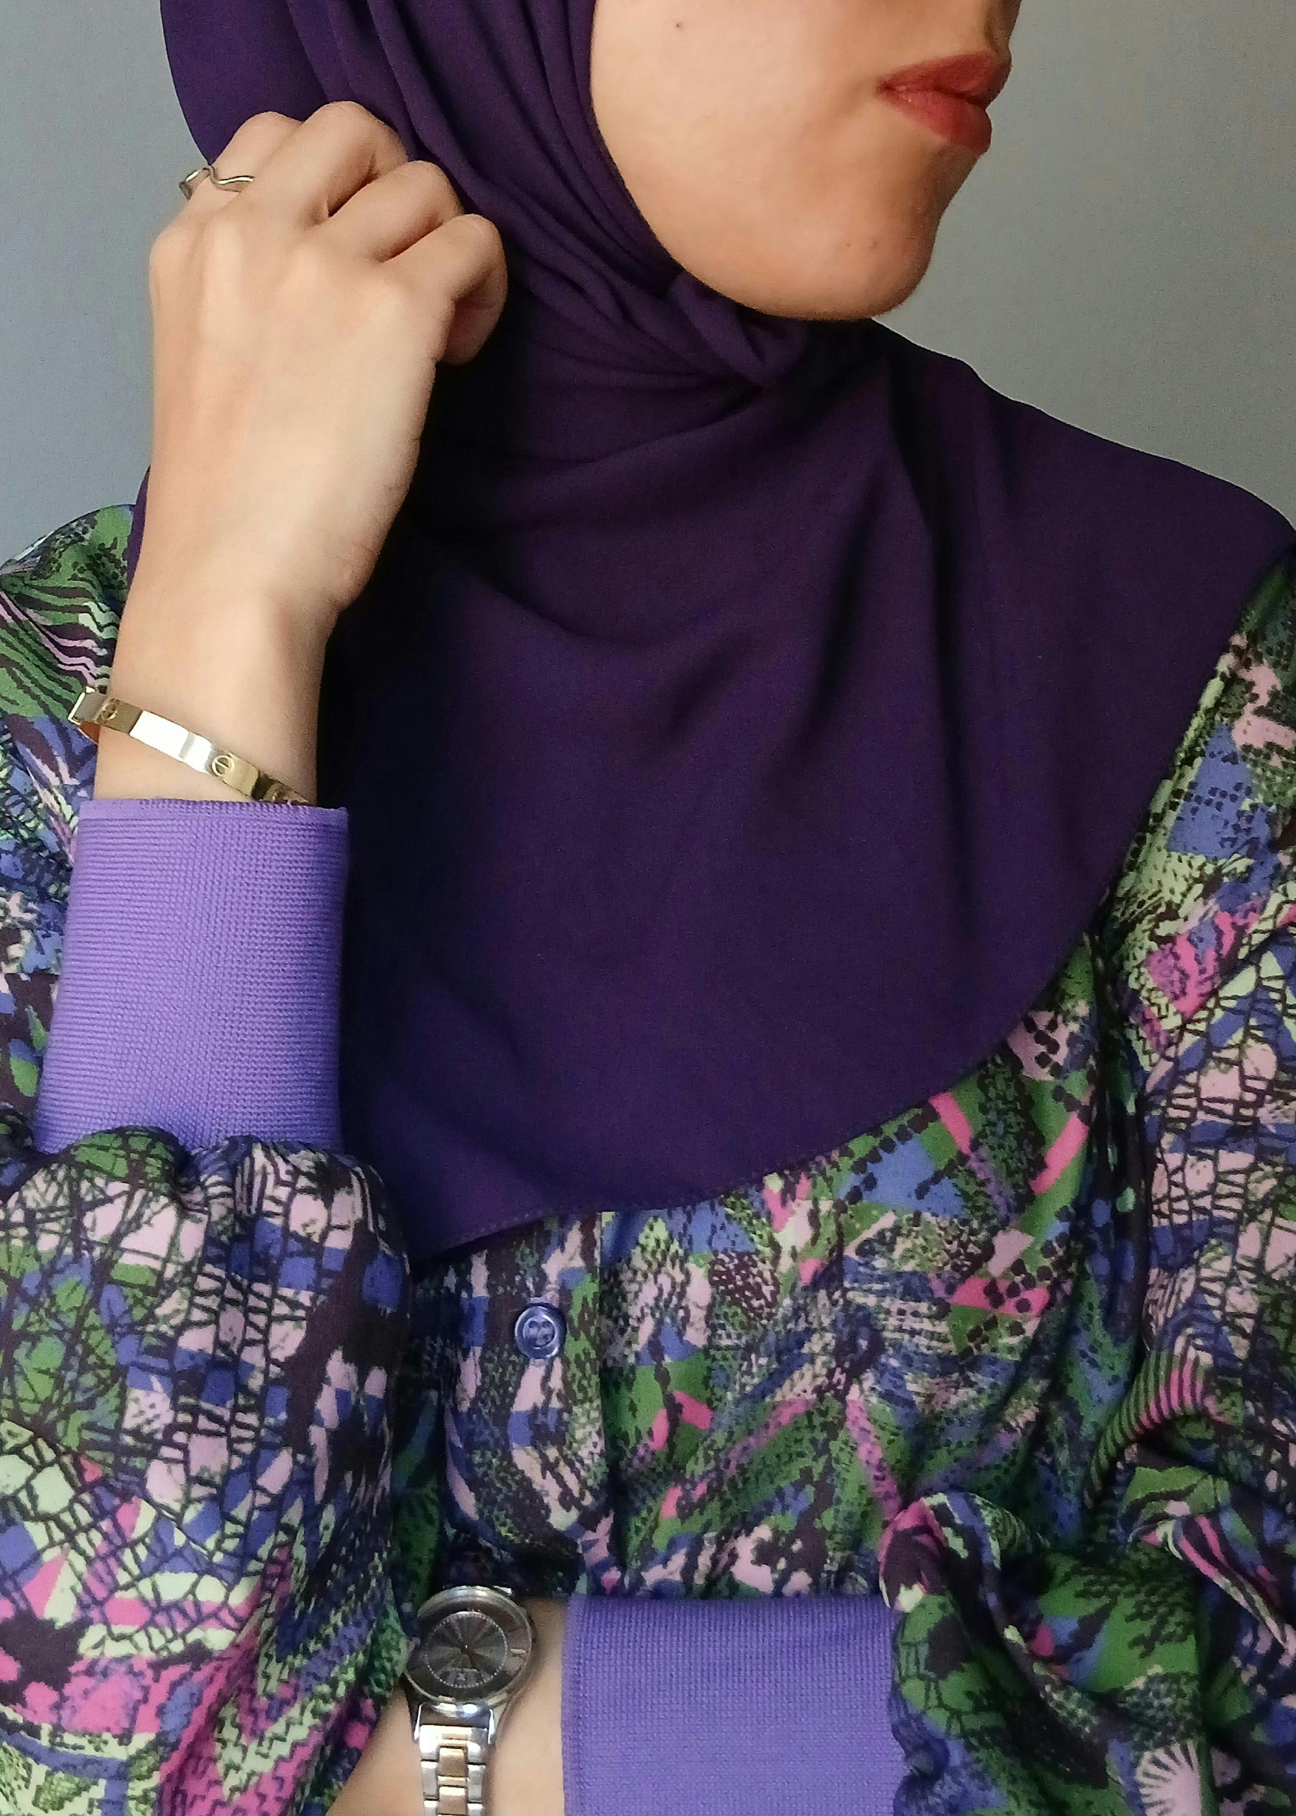
Use Effective Body Language
Eye contact
Posture and position
Movement
Notes:
1 mins
0:19-0:20
Say
Make sure your physical movements and positioning accurately show what you're feeling or trying to communicate. Your body language, eye contact, posture, and movement impact how your message is received. It also is important when listening. This includes nodding, smiling, making appropriate eye contact, sitting or standing up straight, and leaning in when listening. Use physical movements and positioning that accurately show what you're feeling or trying to communicate.
Example: When a staff member approaches you during a hectic afternoon to report a problem, stop what you're doing, turn your body to face them, maintain eye contact, and lean in slightly to show you're giving them your full attention – even if it's just for a quick conversation.

Slide 13
How Often Do You…?
Use effective body language
Communicate clearly
Confirm understanding
Take turns
Choose delivery method
Actively listen
Demonstrate self-awareness
Notes:
5 mins
0:20-0:25
In-Person Activity – Poll
We’re going to do a poll – and keep it moving a little. I’m going to have you rate how often you do each of the items listed on the screen. This is not designed to be a “test” but instead to be an opportunity to reflect. We are going to do head-shoulders-knees.
When I say each statement, you will either put your hands above your head for often. Model as you explain.
Put your hands on your shoulders for sometimes. Model as you explain.
Put your hands on your knees for rarely. Model as you explain.
Let’s start with the first one. How often do you… communicate clearly.
Often Hold hands above your head to model.
Sometimes Put hands on your shoulders to model.
Or rarely Put hands on your knees to model.
Repeat these for each box on the screen.
Virtual Activity – Poll
Let’s take a moment to reflect on these communication behaviors. We’re launching a poll and we are asking that you rate how often you utilize these good communication behaviors.
Launch poll.
Questions
How often do you communicate clearly?
How often do you confirm understanding?
How often do you take turns?
How often do you intentionally choose a delivery method?
How often do you actively listen?
How often do you demonstrate self-awareness?
How often do you use effective body language?
Answers (these are the same for each question):
Often
Sometimes
Rarely
Debrief
Observe & Identify Concepts
Comment on results. What about the behaviors that you use most often make your communication successful?
Apply
How will you work to improve your communication behavior that you feel you do the least?

Slide 14

Teamwork
Know the Enemies
Notes:
2 mins
0:25-0:27
Say
New OST staff are stepping into established teams and systems, which can be overwhelming without intentional support. Teamwork is when a group shares the responsibility and rewards of working to reach a common goal. By identifying common teamwork challenges and modeling strong communication behaviors, experienced staff can foster collaboration, reduce misunderstandings, and help new team members integrate more smoothly and confidently. Practicing teamwork takes intentionality. Conquer the enemies of teamwork by understanding them and putting good communication behaviors to work.
What is one challenge you have encountered when working on a team? Get responses from your audience.
Debrief
Observe & Identify Concepts
Comment on responses. What challenges do we have in common?
Apply
What are lessons you learned as a team member that will assist you in strengthening the team you are working on now?

Slide 15
Enemies of Teamwork
Avoidance of accountability
Absence of trust
Fear of conflict
Inattention to results
Lack of commitment
Teams must commit to rules of engagement around timeliness at meetings, responsiveness in communication, and general interpersonal behavior.
-Patrick Lencioni
Notes:
5 mins
0:27-0:32
Say
It's important to acknowledge the things that can negatively impact teamwork.
Absence of trust – This is where we see a lack of vulnerability, which inhibits the open, honest communication necessary to progress.
Fear of conflict – Conflict and confrontation can be challenging, but when we fail to express disagreement, point of view, or even ask questions of one another we place our common goal at risk.
Accountability avoidance – Failure to take responsibility for behaviors and outcomes and/or to hold peers responsible for theirs
Inattention to results – Team goals and progress towards them are not the focus of the individual team members
Lack of commitment of a failure to adhere to the agreements, standards, and norms necessary to move the team forward
This is not about consensus, but rather about choosing to act in ways that benefit the program which means leaders must listen to ideas and perspectives
The program culture becomes what the team commits to practicing – Click to display quote. “Teams must commit to rules of engagement around timeliness at meetings, responsiveness in communication, and general interpersonal behavior.” –Patrick Lencioni
Source
Lencioni, P. (2005). Overcoming the Five Dysfunctions of a Team. Jossey-Bass.

Slide 16
Everything’s Fine
During staff meetings, seasoned team members only share positive updates about their groups and never mention challenges while new staff remain quiet, even when struggling with difficult behaviors.
Communicate clearly
Confirm understanding
Take turns
Choose delivery method
Actively listen
Demonstrate self-awareness
Use effective body language
Self-awareness
Communicate clearly
Notes:
8 mins (5 slides)
0:32-0:40
In-Person Activity – Group Work
Let’s look at a few scenarios. Each one presents an enemy of teamwork. Consider the seven behaviors for good communication and identify which behavior you would use to improve teamwork. Discuss your answers with your group, then I will ask groups to share out their answers. Form groups as needed. This can also be done by table, etc.
Scenario: During staff meetings, seasoned team members only share positive updates about their groups and never mention challenges while new staff remain quiet, even when struggling with difficult behaviors.
Answers: Demonstrate self-awareness, Communicate clearly
Virtual Activity – Annotation/Chat
Let’s look at a few scenarios. Each one presents an enemy of teamwork. Consider the seven behaviors for good communication and identify which behavior you would use to improve teamwork. Use your annotation tool to place a heart, check, or star next to the behavior you identified. You can also let us know in the chat.
Scenario: During staff meetings, seasoned team members only share positive updates about their groups and never mention challenges while new staff remain quiet, even when struggling with difficult behaviors.
Answers: Demonstrate self-awareness, Communicate clearly

Slide 17
The Whisper Campaign
You notice that one of your new staff members consistently sets up their activity late, causing delays, but other staff members complain privately rather than addressing it directly.
Communicate clearly
Confirm understanding
Take turns
Choose delivery method
Actively listen
Demonstrate self-awareness
Use effective body language
Take turns
Communicate clearly
Notes:
8 mins
0:32-0:40
In-Person Activity – Group Work
Virtual Activity – Annotation/Chat
Scenario: You notice that one of your new staff members consistently sets up their activity late, causing delays, but other staff members complain privately rather than addressing it directly.
Answers: Take turns, Communicate clearly

Slide 18
The Blame Game
A new staff member thinks the pickup procedure is "just a guideline" and creates their own shortcuts, like releasing children to anyone who looks like family.
Communicate clearly
Confirm understanding
Take turns
Choose delivery method
Actively listen
Demonstrate self-awareness
Use effective body language
Confirm understanding
Delivery method
Notes:
8 mins
0:32-0:40
In-Person Activity – Group Work
Virtual Activity – Annotation/Chat
Scenario: A new staff member thinks the pickup procedure is "just a guideline" and creates their own shortcuts, like releasing children to anyone who looks like family.
Answers: Confirm understanding, Choose delivery method

Slide 19
The Slow Start
Afternoon activities are supposed to begin at 3:30 PM, but some of your new staff members consistently begin 10-15 minutes late without explanation.
Communicate clearly
Confirm understanding
Take turns
Choose delivery method
Actively listen
Demonstrate self-awareness
Use effective body language
Delivery method
Communicate clearly
Notes:
8 mins
0:32-0:40
In-Person Activity – Group Work
Virtual Activity – Annotation/Chat
Scenario: Afternoon activities are supposed to begin at 3:30 PM, but some of your new staff members consistently begin 10-15 minutes late without explanation.
Answers: Choose delivery method, Communicate clearly

Slide 20
The Silent Struggle
A new staff member makes mistakes but doesn't ask questions because they're afraid of looking incompetent in front of experienced colleagues.
Communicate clearly
Confirm understanding
Take turns
Choose delivery method
Actively listen
Demonstrate self-awareness
Use effective body language
Body language
Actively listen
Notes:
8 mins
0:32-0:40
In-Person Activity – Group Work
Virtual Activity – Annotation/Chat
Scenario: A new staff member makes mistakes but doesn't ask questions because they're afraid of looking incompetent in front of experienced colleagues.
Answers: Use effective body language , Actively listen
Debrief
Observe & Identify Concepts
Comment on responses. What are some of the enemies of teamwork that you are experiencing in your program?
Apply Take a moment to consider how to apply the ideas we have discussed about communication and teamwork. Choose one of the behaviors associated with good communication and describe how you can use it to overcome a challenge with your team. Share your thoughts in the chat.

Slide 21
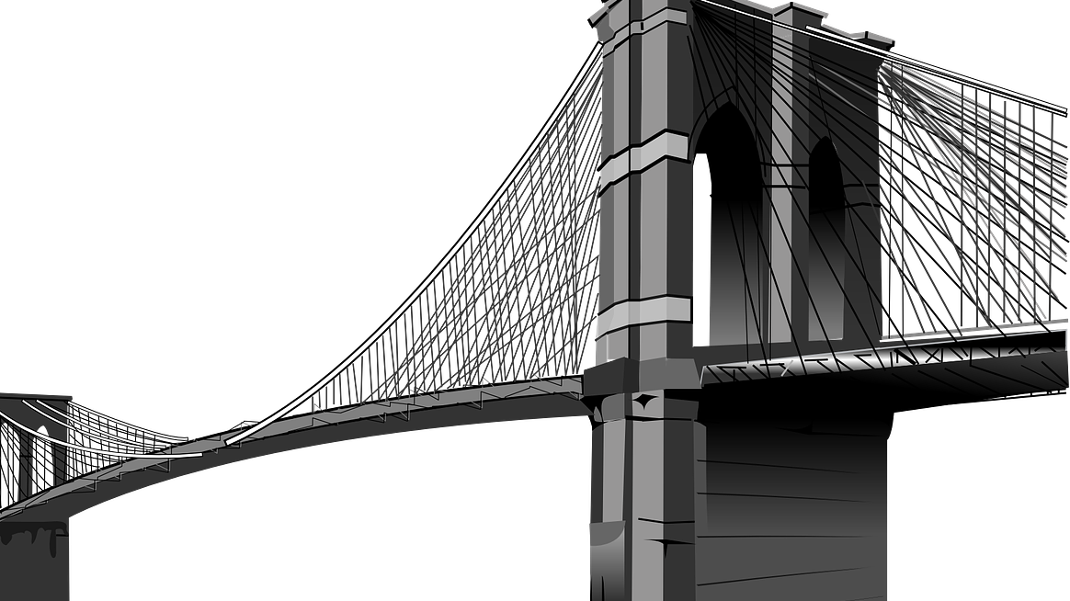
Problem-Solving
The Bridge Model
Notes:
1 mins
0:40-0:41
Say
Supporting new OST staff means helping them navigate both everyday challenges and larger systemic issues with confidence. By teaching a structured approach like The Bridge Model, we equip them with a clear process to assess situations, generate solutions, and take action. This builds their problem-solving skills and empowers them to respond thoughtfully rather than reactively. Problem-solving happens when you're faced with a situation that takes some thinking to move from where you are now to where you want to be. In OST programs, problems can range from big-picture issues like policies and politics to day-to-day challenges with individual students. Just like problems vary, so do the ways we tackle them. In this section, we’ll explore a strategy used in engineering called The Bridge Model to help guide our problem-solving.
Source
Adair, J. (2007). Decision making and problem solving strategies. Kogan Page Limited. http://edl.emi.gov.et/jspui/bitstream/123456789/158/1/Decision%20Making%20and%20Problem%20Solving%20Strategies%20by%20John%20Adair%20%28z-lib.org%29.pdf

Slide 22
The Bridge Model
Abstract
Why is it happening? | What could we do?
What is the current situation? | What will we do?
Concrete
Present
Future
Notes:
5 mins
0:41-0:46
Say
The Bridge Model is a problem-solving tool from engineering that helps you move from where you are now (your current situation) to where you want to be (your desired outcome). It works by guiding you to explore possible ideas and solutions – starting with what’s real and concrete, and then thinking about future possibilities.
The model uses two paths:
Click to display arrow One moves from the present to the future
Click to display arror The other moves from the concrete (what exists now) to the abstract (new ideas)
To solve a problem, you move through all four parts of the model, using creative thinking to explore options and then turning those ideas into action to reach your goal.
Click to display question. What is the current situation?
This is where you start. You define and describe the problem as it exists right now. You're focused on facts, realities, and specific details.
Click to display question. What are some possible reasons or interpretations?
You start thinking more broadly about why the current situation exists. This is a space for analysis, patterns, and brainstorming causes. You're thinking creatively and conceptually about the present state.
Click to display question. What could be possible?
Now you're imagining what a better future could look like. You explore options, opportunities, and goals. Still abstract, but looking forward.
Click to display question. What specific action steps will get us there?
You’re narrowing it down to concrete solutions and plans. These are the actions you’ll actually take to reach the desired state.

Slide 23
The Bridge to Better
Abstract
Why is it happening? | What could we do?
What is the current situation? | What will we do?
Students regularly participate in fun activities like sports, arts, and cooking. However, the academic enrichment activities have low attendance and engagement. Students often skip these sessions and are disengaged when they do attend. Your newer staff members aren’t sure what to do.
Concrete
Present
Future
Notes:
5 mins
0:46-0:51
In-Person Activity – Discussion/Chart Paper
Let’s look at a scenario and walk through using The Bridge Model.
Students regularly participate in fun activities like sports, arts, and cooking. However, the academic enrichment activities have low attendance and engagement. Students often skip these sessions and are disengaged when they do attend. Your newer staff members aren’t sure what to do.
Click to display the matrix.
What you’re going to do is draw The Bridge Model on a piece of chart paper and with your group record the answers to each question. Once you finish, prepare to share your model.
Virtual Activity – Poll
Let’s look at a scenario and walk through using The Bridge Model.
Students regularly participate in fun activities like sports, arts, and cooking. However, the academic enrichment activities have low attendance and engagement. Students often skip these sessions and are disengaged when they do attend. Your newer staff members aren’t sure what to do.
Click to display the matrix.
We’re going to launch a poll and walk through the questions in the quadrants.
Poll
What do we know is happening now? (Check all that apply)
Academic enrichment sessions are poorly attended.
Students appear bored or distracted.
Staff feel frustrated and say it’s hard to get students to focus.
Some students complain that it feels like "more school.
Why do you think this happening? (Check all that apply)
Students may be mentally tired after the school day.
Activities may not feel relevant or engaging.
There's a possible mismatch between student interests and the content.
The structure feels too formal and rigid.
Staff may not feel confident in delivering academic content creatively.
What could be done to reinvigorate attendance and engagement? (Rank each by anticipated effectiveness)
Reimagine academic enrichment as hands-on, student-driven projects.
Integrate academics into other engaging formats like STEM challenges or game-based learning.
Offer student choice and voice in topics.
Provide staff with training on integrating academics in fun and informal ways.
Include academic elements in popular activities (e.g., budgeting for cooking, journaling after sports).
What would be your next course of action?
Redesign enrichment blocks to include project-based learning tied to academic skills.
Survey students to find out what topics interest them.
Pilot two new “fun-learning” sessions next month, co-led by staff and students.
Schedule a staff training on blending academics with youth development activities.
Monitor attendance and engagement during the pilot and adjust based on feedback.
Debrief
Observe & Identify Concepts
Comment on responses. What benefit could utilizing the bridge model bring to your team?
Apply
How could using the bridge model help you and your team work through a problem you are experiencing presently?

Slide 24
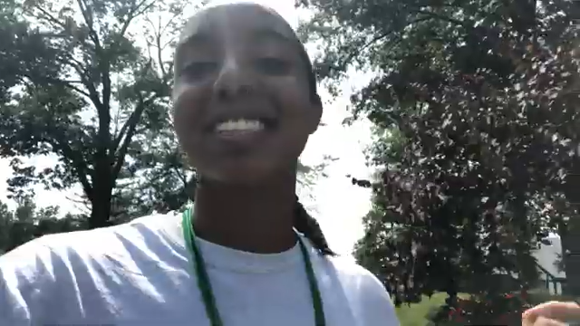
Dismissal Woes
What’s the problem?
What communication behaviors could help solve the problem?
How would you support this young staff member?
Notes:
5 mins
0:51-0:56
Activity – Chat/Discussion
Let’s take a listen to a young camp counselor. As you listen, be thinking of what would you do as a leader to support your team and help a young staffer address the problem.
Click to play clip.
Debrief
Observe & Identify Concepts
Walk through questions and comment on responses. Click to display each question.
What’s the problem?
What communication behaviors could help solve the problem?
How would you support this young staff member?
Apply
How would address a similar challenge in your own program?
Source
https://youtu.be/tb9wE_7gfY4

Slide 25
Keep It Going
Identify communication behavior needing improvement
Use The Bridge Model to solve a problem
Notes:
4 mins
0:56-1:00
Say
I suggest that you put the ideas from today’s session into practice right away. Some ways to do that are to
Identify a communication behavior that you could improve upon.
Utilize the bridge model to tackle a problem with your team that you are experiencing in your program.

